Slide 1
Training Digital Signal Processing
ELETDS02
Introductie
brojz@hr.nl
muiko@hr.nl
Original author: Johan Peltenburg

Slide 2
What is digital signal processing?
A subject of mathematics and engineering that involves manipulation of digital signals.
Applications:
  Multimedia (MP3, MPEG-2 video, etc...)
  Health (EEG, MRI scan, CT scan, hearing aid)
  Telecom (Phones, modems, etc...)
  Industry (PID controllers, smart sensors, sensor fusion, motor
  controllers)
  Automotive (Radar, Lidar, Vision, motor management)

Slide 3
Telecommunication application: echo cancellation
For example used with hands-free calling; the microphone also records the sound produced by the speaker.
These signals can be suppressed by DSP techniques so that the echo is canceled.

Slide 4
Industrial application: Digital Control Systems
Automatically tuning a PID controller in a process or plant.

Slide 5
What is this course about?
Apply DSP theory in practice.
DSP algorithms are widely used in embedded systems.
Learn to use specific processors tailored for DSP.
Implement some DSP algorithms on them.

Slide 6
What will we do
First four weeks tiny lecture about theory
  About one hour
Rest of the time lab

Slide 7
Learning goals

Slide 8
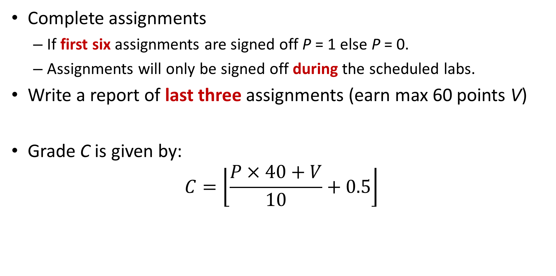
Grade
Complete assignments
  If first six assignments are signed off P = 1 else P = 0.
  Assignments will only be signed off during the scheduled labs.
Write a report of last three assignments (earn max 60 points V)
Grade C is given by:
$$C=\left\lfloor \frac{P×40+V}{10}+0.5\right\rfloor$$

Slide 9
Signals and frequencies
TDS02

Slide 10
Signals in time
We consider real world signals to be analog and of continuous-time.
At any point in time, the signal has an arbitrary value.

Slide 11
Discrete-time signals
A digital processor works with limited numbers in discrete-time.
Therefore we cannot manipulate analog, continuous-time signals.
Need to sample and quantize.
Typical embedded system with DSP:

Slide 12
Digital Signal Processing versus Analog Signal Processing
Advantages:
  Flexibility
  Reliability
  Reproducibility
  Complexity
  Costs
Disadvantages:
  Bandwidth
  Precision

Slide 13
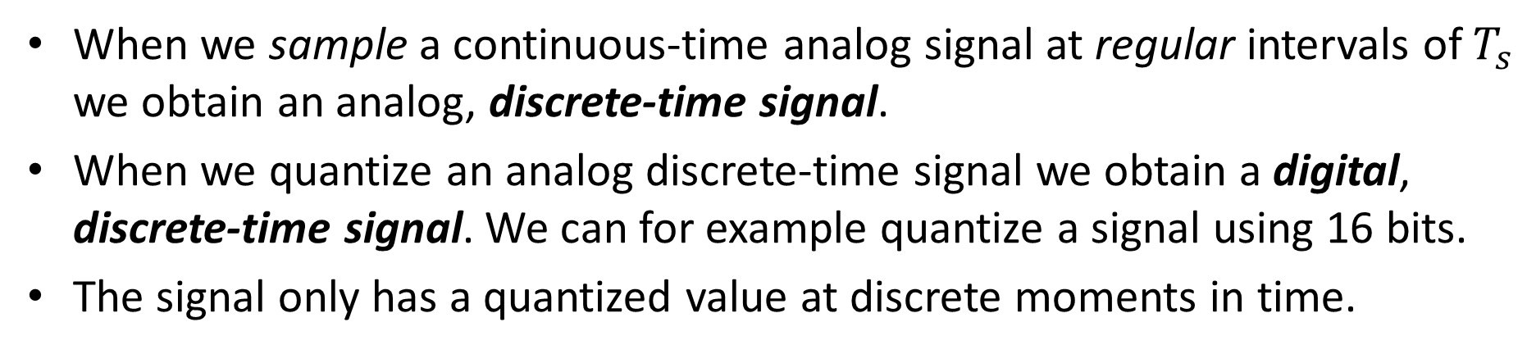
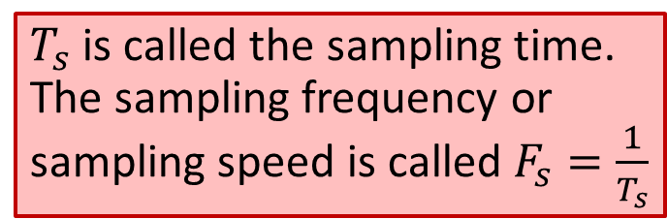
Digital, Discrete-time signals
When we sample a continuous-time analog signal at regular intervals of $T_{s}$ we obtain an analog, discrete-time signal.
When we quantize an analog discrete-time signal we obtain a digital, discrete-time signal. We can for example quantize a signal using 16 bits.
The signal only has a quantized value at discrete moments in time.
$T_{s}$ is called the sampling time. The sampling frequency or sampling speed is called $F_{s}=\frac{1}{T_{s}}$

Slide 14
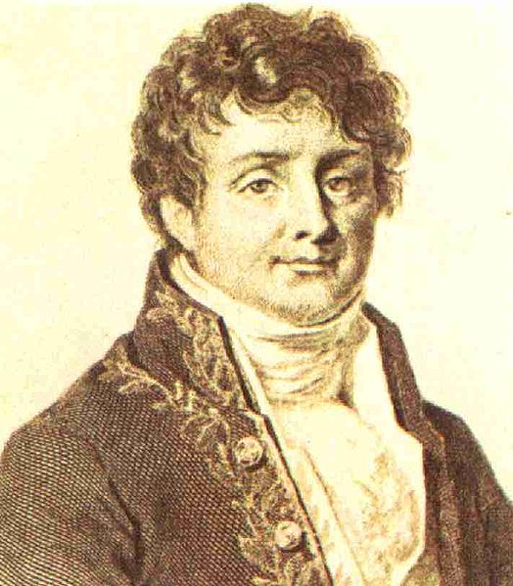
Fourier series
In the beginning of the 19th century there was a mathematician called Jean-Baptiste Joseph Fourier.
He noticed something interesting about periodic signals.

Slide 15
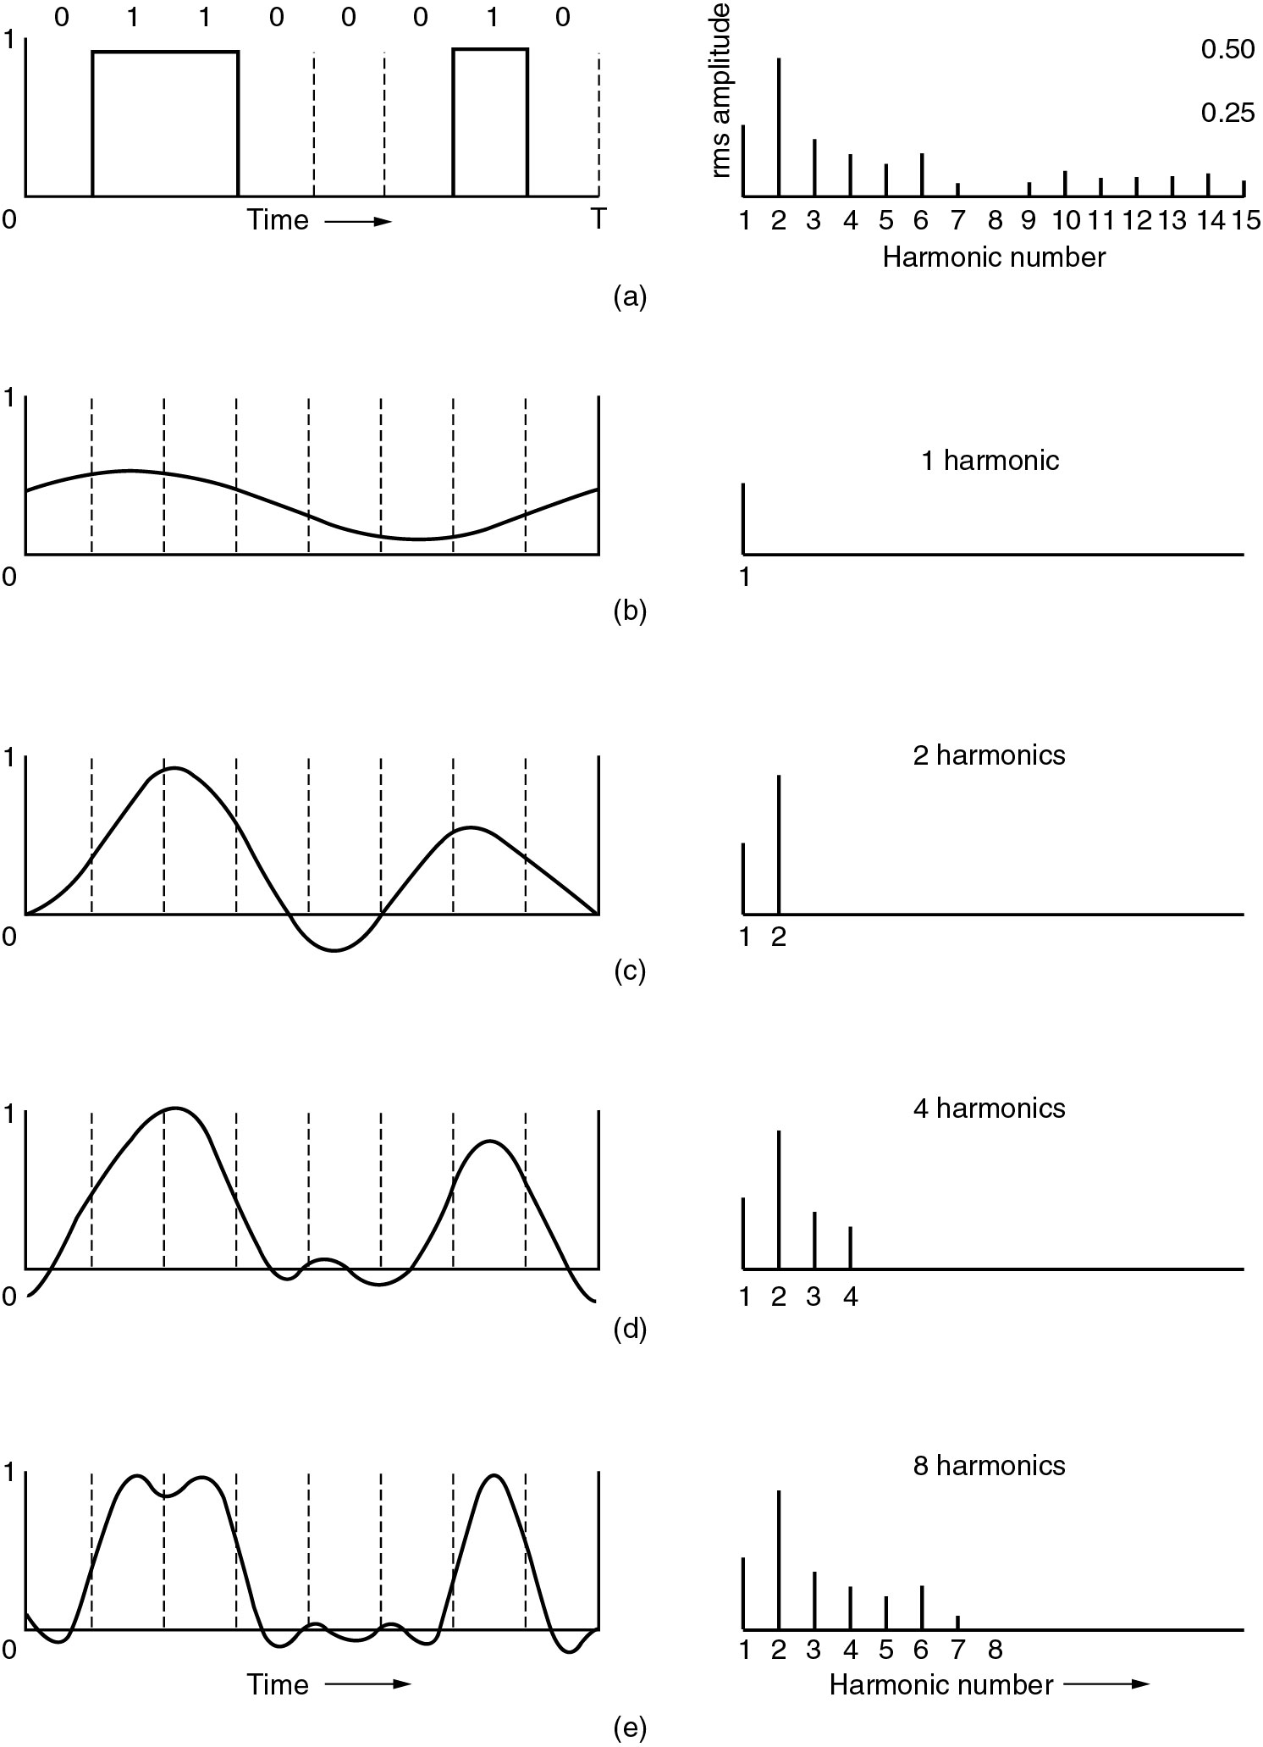
Fourier series example (1)
Binary Signal with Fourier harmonics amplitude
(b) – (c) Successive approximations to the original signal…

Slide 16
Fourier series example (2)
(d) – (e) Successive approximations to the original signal

Slide 17
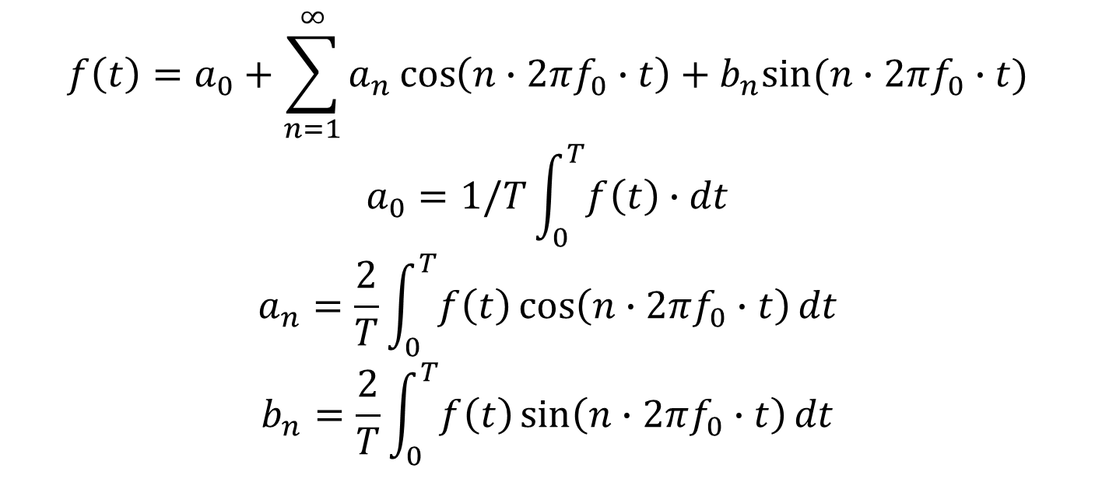
Fourier series
Fourier figured out the mathematics:
$$f\left(t\right)=a_{0}+\sum_{n=1}^{∞}{a_{n}\cos\left(n∙2πf_{0}∙t\right)+b_{n}sin⁡(n∙2πf_{0}∙t)}$$
$$a_{0}=1/T\int_{0}^{T}{f\left(t\right)∙dt}$$
$$a_{n}=\frac{2}{T}\int_{0}^{T}{f\left(t\right)\cos\left(n∙2πf_{0}∙t\right)dt}$$
$$b_{n}=\frac{2}{T}\int_{0}^{T}{f\left(t\right)\sin\left(n∙2πf_{0}∙t\right)dt}$$
Fourier showed that any periodic function can be written as an infinite sum of sine and cosine terms.

Slide 18
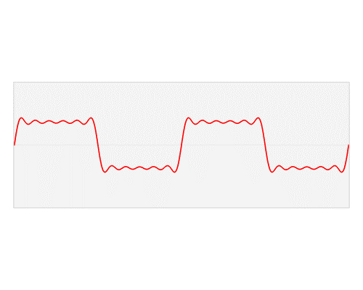

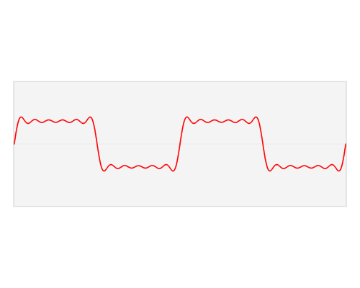
Animation
Source: Lucas V. Barbosa

Slide 19
Fourier transform (1)
(Warning: imperfect simplified description ahead.)
The Fourier series shows the amplitudes of discrete frequencies.
Suppose we apply the calculations on a signal that extends to infinity in time.
The “period” of the signal approaches infinity,
The “frequency” of the signal approaches zero,
The number of frequencies becomes infinite
In a way where the range of frequencies becomes continuous.
We call this the Fourier Transform.
It shows us the signal as a function of frequency instead of time.
This is called the frequency domain representation of the signal.

Slide 20
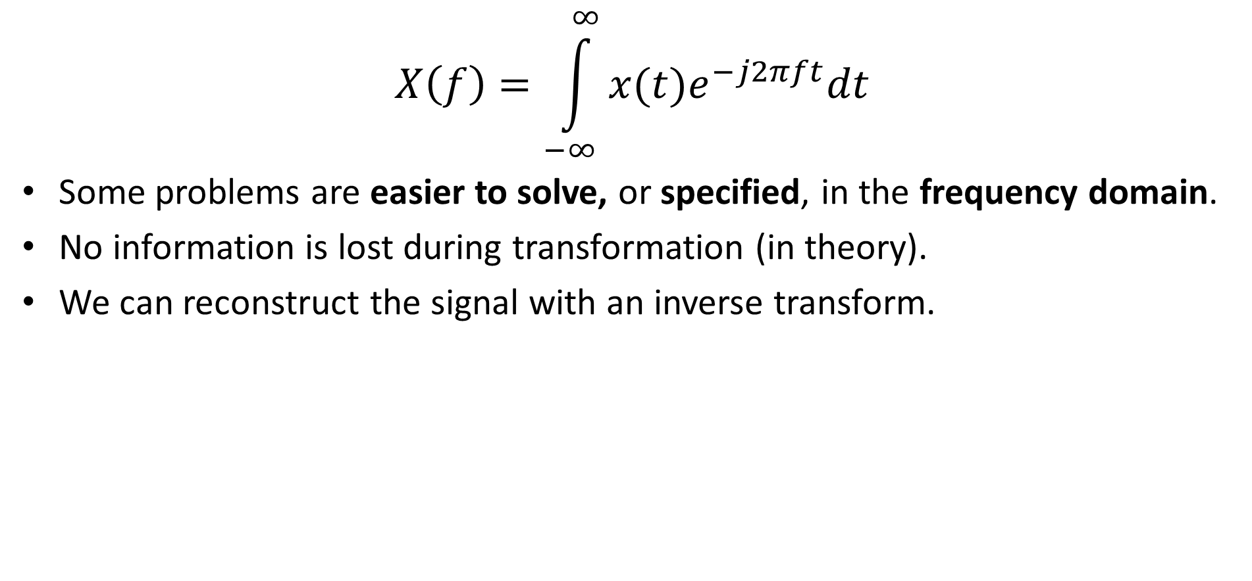
Fourier transform (2)
$$X\left(f\right)=\int_{−∞}^{∞}{x(t)e^{−j2πft}dt}$$
Some problems are easier to solve, or specified, in the frequency domain.
No information is lost during transformation (in theory).
We can reconstruct the signal with an inverse transform.

Slide 21
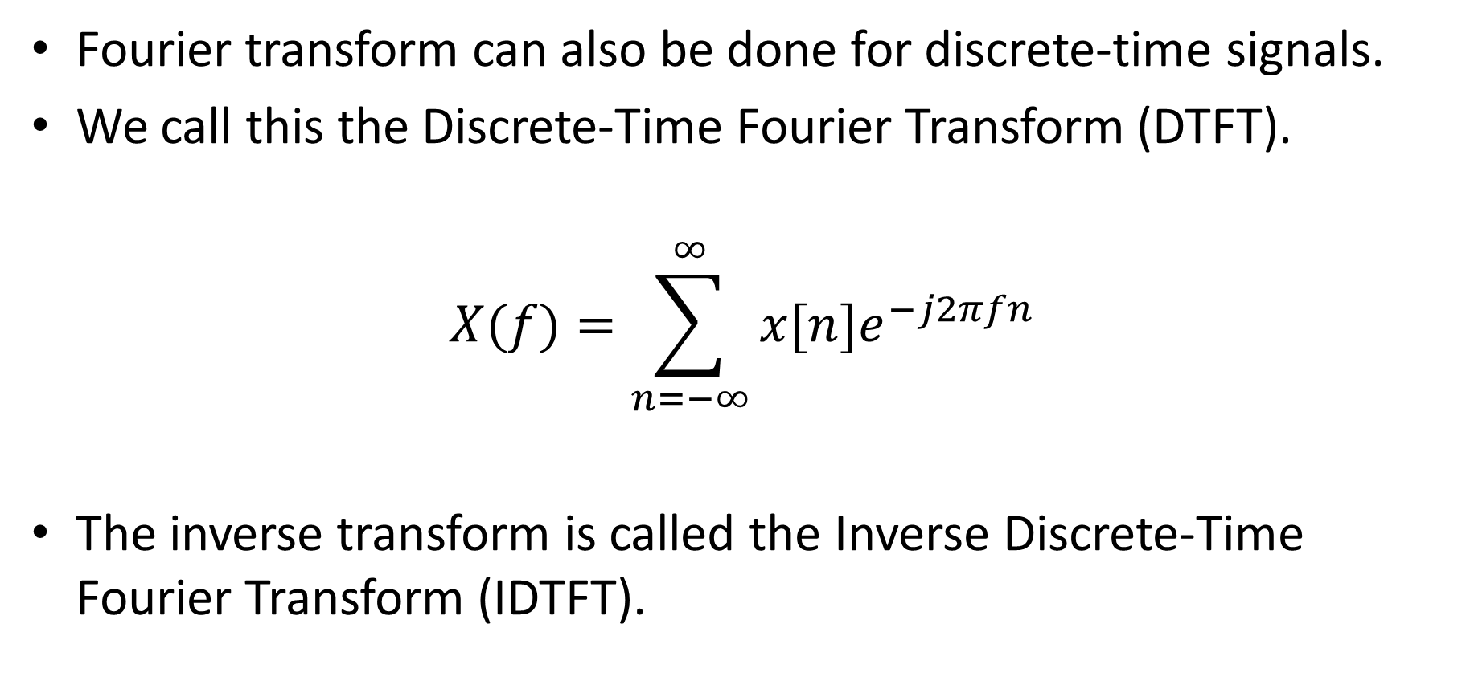
Discrete-time Fourier transform
Fourier transform can also be done for discrete-time signals.
We call this the Discrete-Time Fourier Transform (DTFT).
$$X(f)=\sum_{n=−∞}^{∞}{x[n]e^{−j2πfn}}$$
The inverse transform is called the Inverse Discrete-Time Fourier Transform (IDTFT).

Slide 22
Do we have to fully understand and apply all these formulas?
For this course at least try to understand the differences between time and frequency and the corresponding domain.
  For complete understanding of the subject, you need to do the math.
For this course we try to design and build discrete-time filters.
To design filters: we can use MATLAB.
More on filters next week.

Slide 23
Summary
Signals in real life are analog and continuous.
Need to sample and to quantize them to be able to process them digitally.
They become digital and discrete-time signals.
Signals can be represented as sines/cosines with certain frequencies.
Many problems are specified or solved in the Fourier frequency domain.
We can switch between time and frequency domain with the Fourier Transform.

Slide 24
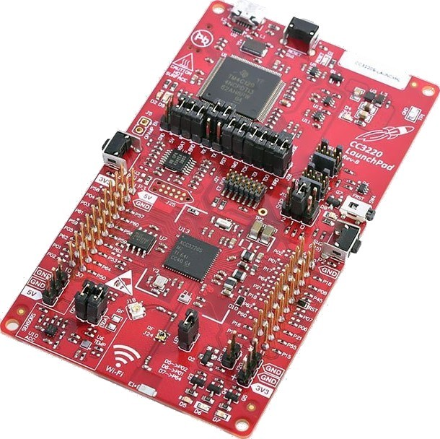
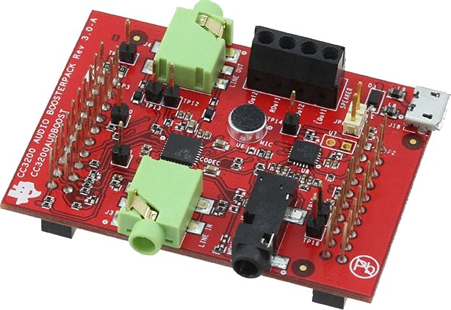
TDS02
Check who’s your groupmember (List)
Get the CC3220S LaunchPad (#17) for €47,50 and the CC3200AUDBOOST Audio BoosterPack (#12) for €17,50 from the shop (mailroom).
Start with assignment 0 from the Lab Work Handbook.

