Slide 1
Training Digital Signal Processing
ELETDS02
FIR / IIR filters
brojz@hr.nl
muiko@hr.nl
Original author: Johan Peltenburg

Slide 2
2 weeks ago
Signals in real life are continuous and analog.
Need to sample them to be able to process them digitally.
They become discrete-time digital signals.
Signals can be represented as sines/cosines with certain frequencies.
Many problems are specified or solved in the Fourier frequency domain.
We can switch between time and frequency domain with the Fourier Transform.

Slide 3
Last week
Filters remove certain frequencies from a signal.
Filters have a transfer function often specified in the frequency domain.
We can implement the filter in the discrete-time domain by using the IDTFT (Inverse Discrete Time Fourier Transform).
(Discrete-time) filters have several characteristic such as response shape (LP, HP, BP, BS), cut-off frequency and others.

Slide 4
FIR filters and windows
TDS02

Slide 5
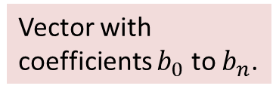
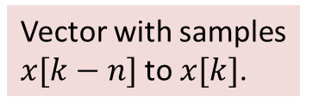
FIR Filter
Last week we obtained a general formula for an FIR filter:
How to get the coefficients?
$$y\left[k\right]=\sum_{n=0}^{N}{b_{n}∙x[k−n]}=\vec{b}∙\vec{x}[k]$$
Vector with samples $x[k−N]$to $x[k]$.
Vector with coefficients $b_{0}$ to $b_{N}$.

Slide 6
FIR filter coefficients
Many methods:
Window Design Method (via IDTFT)
Frequency Sampling (also involves IDTFT)
Weighted Least Squares Method (need statistics :-( )
Some other methods

Slide 7
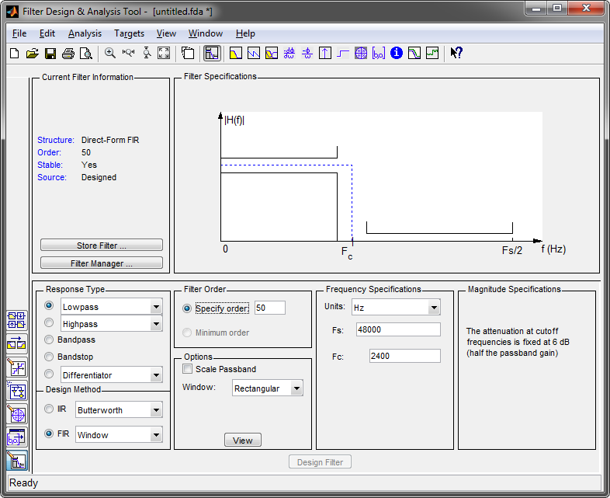
filterDesigner(1)
MATLAB can apply the IDTFT for us.
(It can also do many other methods)
Use filterDesigner:
Set relevant parameters.
Click “Design Filter” ...

Slide 8
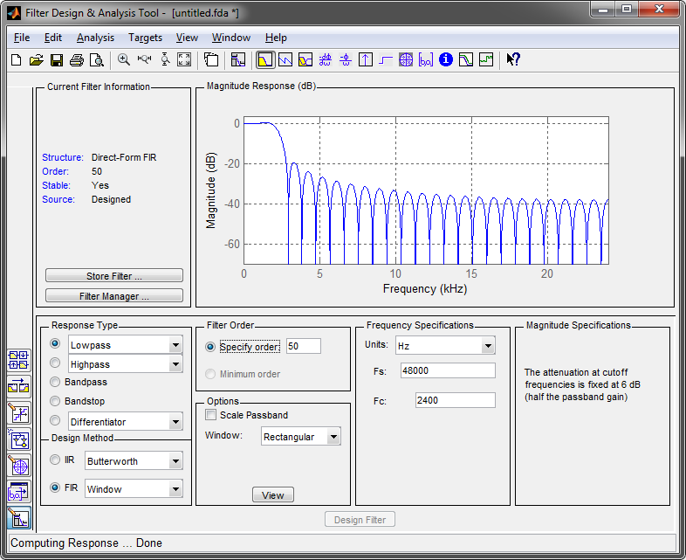
filterDesigner (2)
Resulting magnitude response is shown:
But wait...
A wild sidelobe appears!

Slide 9
Windowing (1)
$$x\left[n\right]= T\int_{\frac{−1}{2Ts}}^{\frac{1}{2Ts}}{X\left(f\right)e^{j2πnfTs}df}$$
The IDTFT is as follows:
But... $n∈ℤ$ . (n can be any integer)
We have an infinite number of coefficients that represents our filter in time. :-(
To implement a filter in practice , we need to have a finite number of coefficients.
The filter order specifies how many coefficients we use:
(For an N-th order FIR filter we need N samples.)
$$y\left[k\right]=\sum_{n=0}^{N}{b_{n}∙x[k−n]}=\vec{b}∙\vec{x}[k]$$

Slide 10
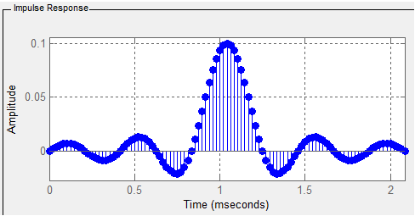
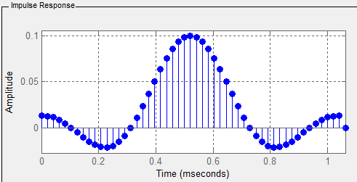
Windowing (2)
Windowing is limiting the number of coefficients (to the desired filter order) in a certain way.
For example with a “rectangular” window:
Windowed filter:
We adjust the filter in time, what is the effect in frequency?
This would go on to infinity

Slide 11
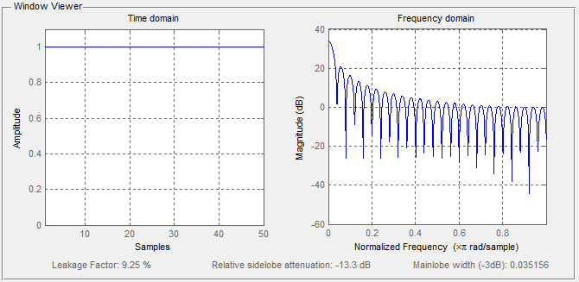
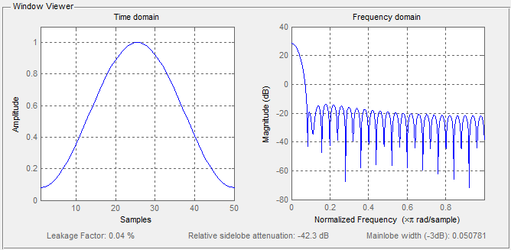
Windowing (3)
A rectangular window is not the only window:
We can let the coefficients at the edges go to zero more smoothly:
Rectangular
Different effect on frequency!
Hamming

Slide 12
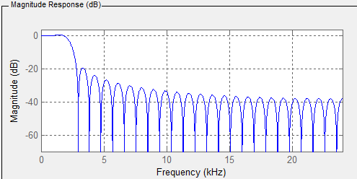
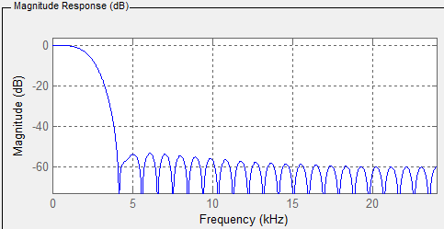
Windowing (4)
LP filter with rectangular window:
Same filter with Hamming window:
What did we gain?
What did we lose?

Slide 13
IIR filters
TDS02

Slide 14
IIR filters
FIR is a non-recursive filter (no feedback).
Discrete-Time filters with feedback exist:
We call them Infinite Impulse Response filters (why?).
The filter is some kind of difference equation.
We have a special frequency domain for this called the Z-domain.
It is very closely related to the Fourier frequency domain.
$$y\left[n\right]= \sum_{k=0}^{N}{b_{k}∙x\left[n−k\right]}−\sum_{i=1}^{M}{a_{i}∙y\left[n−i\right]}$$

Slide 15
Even more transforms
IIR filters are much more effective with the same number of calculations (coefficients).
However, because they contain feedback, the output can become unstable.
They are often designed by looking at their well studied continuous-time equivalents.

Slide 16
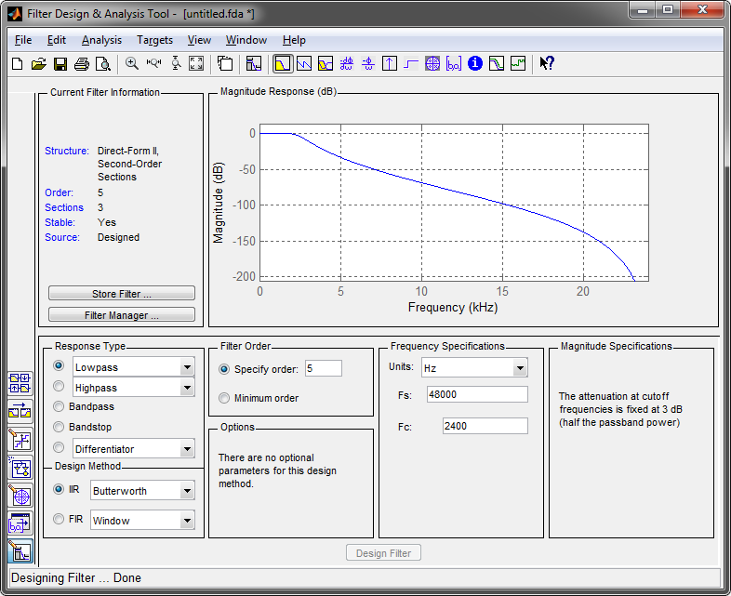
IIR in filterDesigner
filterDesigner does the math.
(A simple example is given in the lab handbook if you’re interested.)

Slide 17
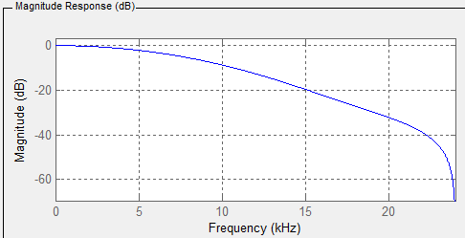
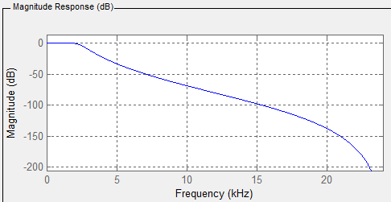
Comparison of FIR and IIR (1)
FIR:
5th order
Fc = 2.4 kHz
Magnitude (dB)
IIR (Butterworth):
5th order
Fc = 2.4 kHz
Magnitude (dB)
Fc
≈ -3 dB
≈ -15 dB

Slide 18
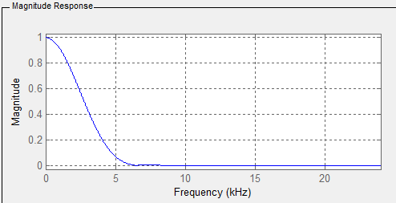
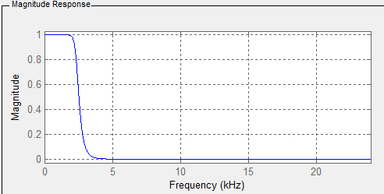
Comparison of FIR and IIR (2)
FIR (Hamming window):
Fc = 2.4 kHz
20th order
Magnitude
IIR (Butterworth):
Fc = 2.4 kHz
10th order
Magnitude
Roughly the same number of calculations

Slide 19
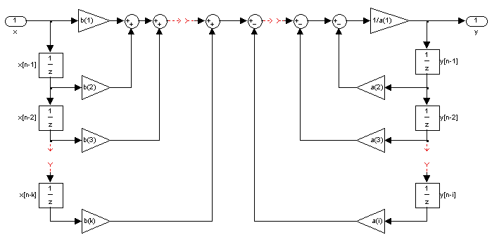
IIR filter structures
For IIR filters different implementation structures exist (see lab handbook).
Simplest form (Direct Form I):
$$y\left[n\right]= \sum_{k=0}^{N}{b_{k}∙x\left[n−k\right]}−\sum_{i=1}^{M}{a_{i}∙y\left[n−i\right]}$$
Addition (watch the signs!)
Multiplication
Delay of $\frac{1}{F_{s}}$

Slide 20
Summary
The IDTFT gives us an infinite number of coefficients of our FIR filter.
To implement the filter in practice we need to apply windowing.
Rectangular windowing might introduce unwanted effects in the frequency domain.
Different window formulas exist that try to keep certain unwanted effects to a minimum. (Experiment with these!)
IIR filters contain feedback (or are recursive).
With only a few coefficients good results can be achieved .
Might be unstable.

