Slide 1
Distributed systems in Haskell, the P2Pmedia application­
Supervisor - Peter Schachte
Student - Han-Hui Chiao

Slide 2
Project contributions
Demonstrate Haskell is ready for real world application.
Demonstrate Haskell excels at distributed systems.

Slide 3
What is distributed system?
“A distributed system is one in which the failure of a computer you didn’t even know existed can render your own computer unusable” --(Leslie Lamport)

Slide 4
Programming Is Hard
Spent a day finding one bug.
Unable to read old code.
Don’t know why your code is working.

Slide 5
Programming Is Hard
"The hardest problems in modern software lie in performance, modularity, reliability, and concurrency.“
-- Tim Sweeney,
founder of Epic Games, and
designer of the Unreal game
engine

Slide 6
Distributed Systems Is Harder
Partial failure
Lack of a central resource manager

Slide 7
Actor Model
All components communicating via message passing.
Asynchronies of communication between
The lack of shared state
No locks needed

Slide 8
In The Real World……
Erlang has been successfully used in production systems for over 20 years [1]
Amazon uses Erlang to implement SimpleDB, providing database services as a part of the Amazon Elastic Compute Cloud (EC2) [2]
Facebook uses Erlang to power the backend of its chat service, handling more than 100 million active users.
WhatsApp uses Erlang to run messaging servers, achieving up to 2 millions of connected users per server
Other: Motorola, Nokia, T-Mobile, BT, Amazon, Yahoo!, Facebook, Github, Goldman Sachs[3][4]

Slide 9
Why not programming in Erlang?
Purity

Slide 10
Cloud Haskell
Purity
Type System
Monads
Interface: Yesod (Haskell web framework)

Slide 11
Why is it not popular?
Steep learning curve
Reputation as an academic language
Myth of not supported well

Slide 12
Real World Problem
Advance of technology has made the world a smaller place.
However, communities are more disjointed.

Slide 13
Solution
Make connections base on people close to you: etc. neighbor, classmates…..
Create a centralized place to socialize
Place responsibility and reliance on each individual and grow as a group

Slide 14
Peer to peer social media
Peer to peer based
Tweeter Wikipedia hybrid (other services can easily be plugged-in)
Information stored on each individuals device

Slide 15
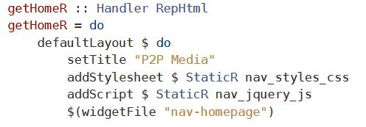
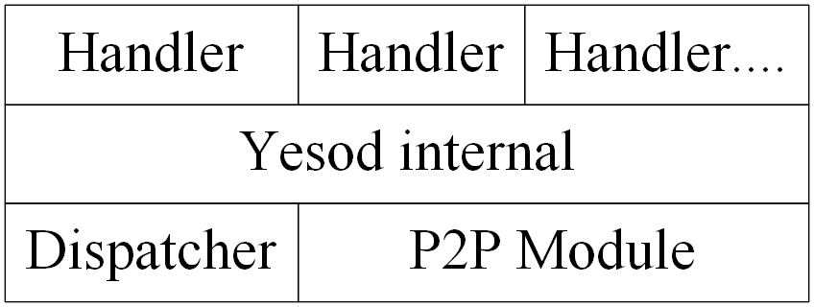
A Peer

Slide 16
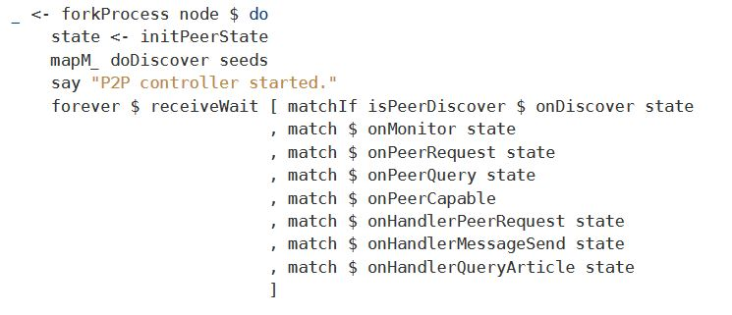
Peer Discovery [6]

Slide 17
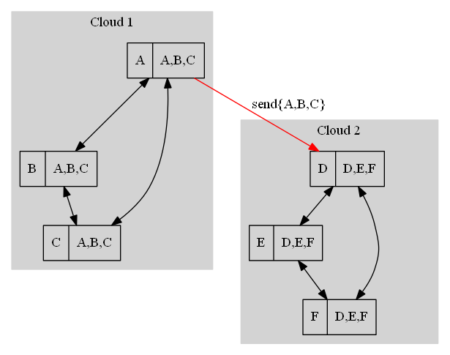

Slide 18
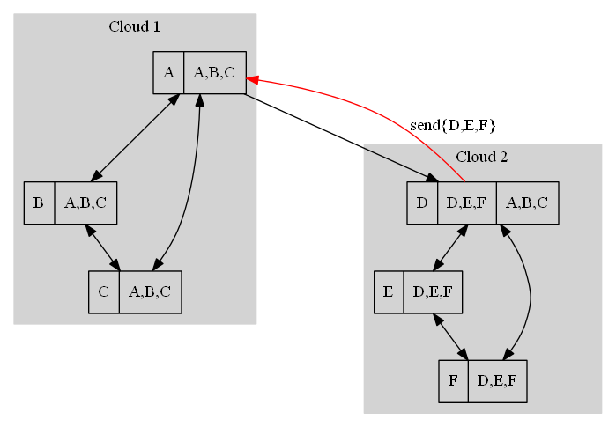

Slide 19
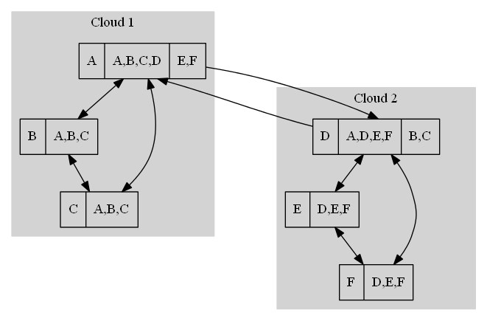

Slide 20
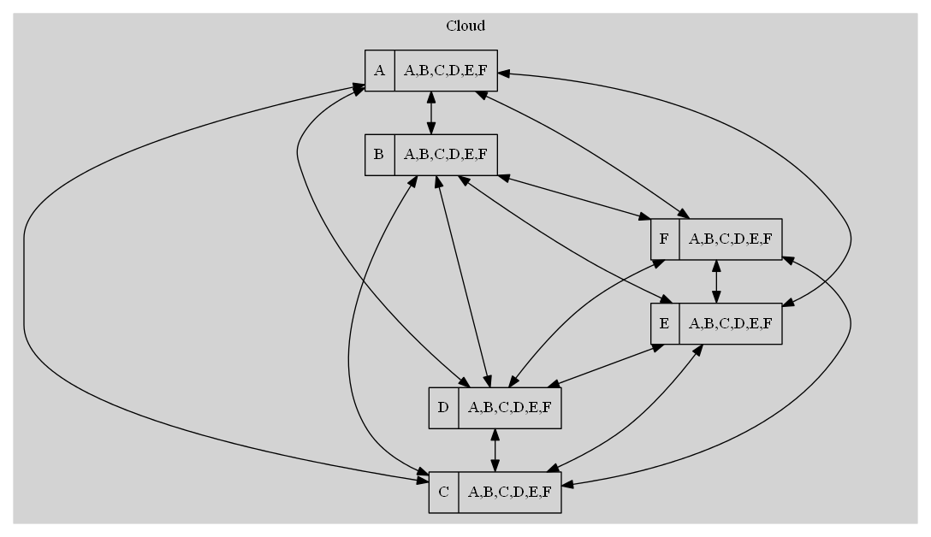

Slide 21
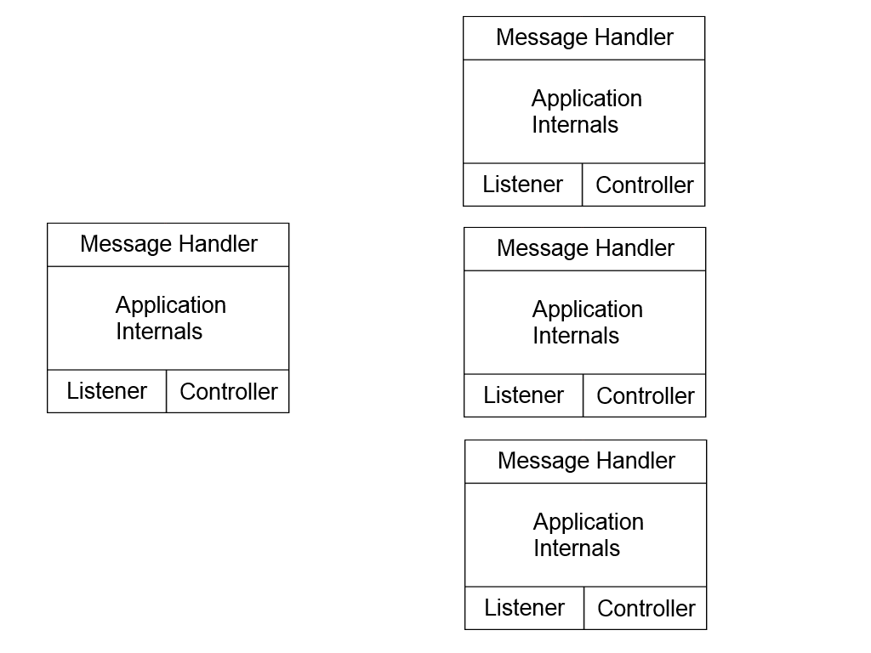
Global Message (Tweeting)

Slide 22
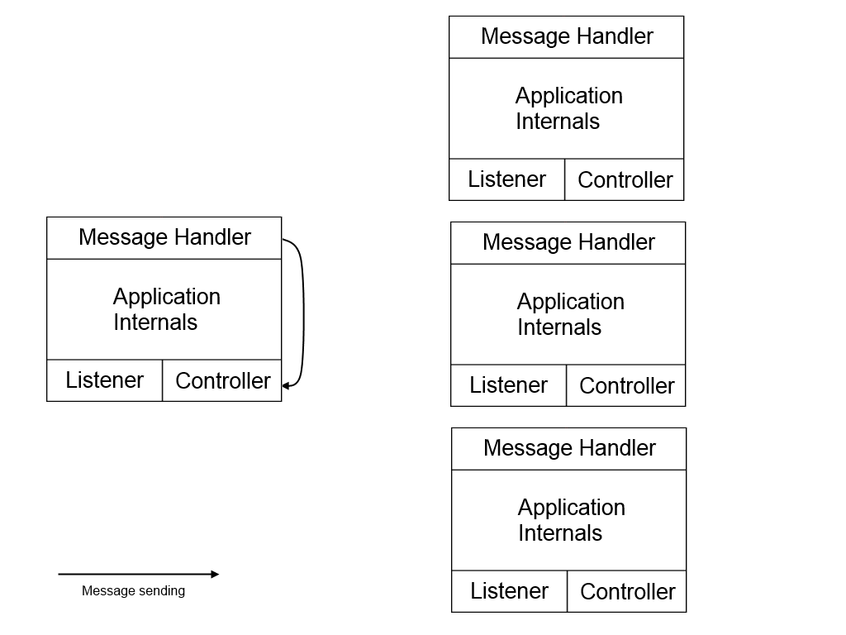
Global Message (Tweeting)

Slide 23
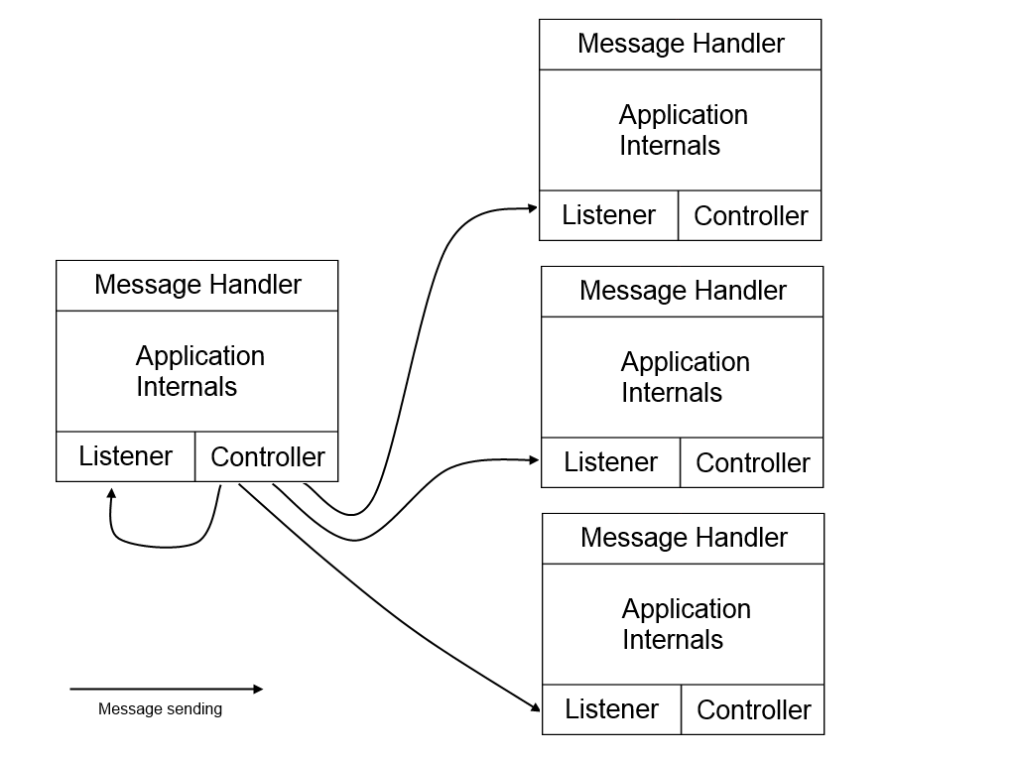
Global Message (Tweeting)

Slide 24
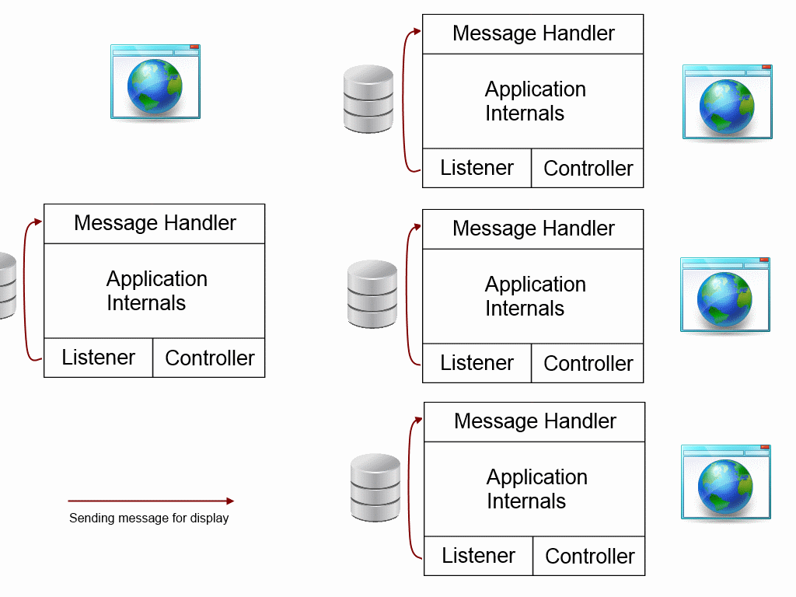
Global Message (Tweeting)

Slide 25
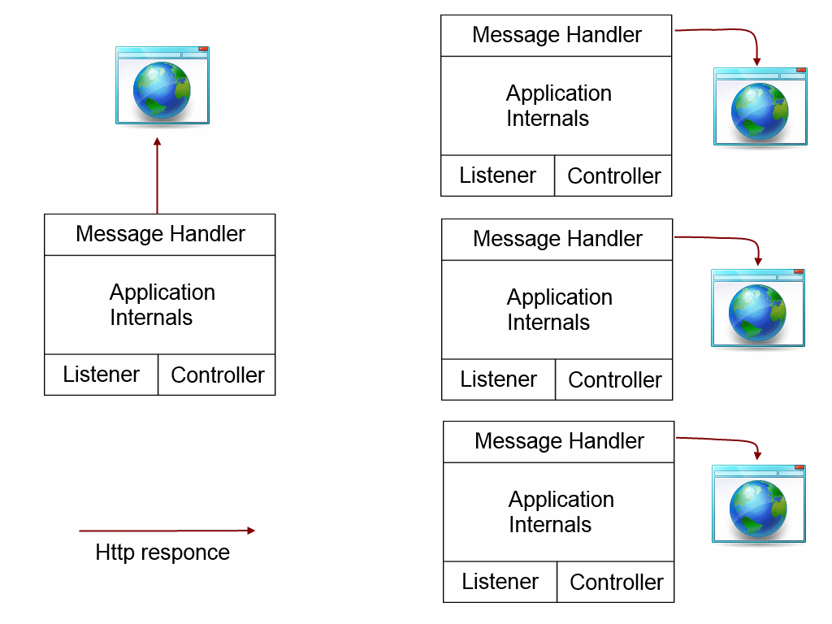
Global Message (Tweeting)

Slide 26
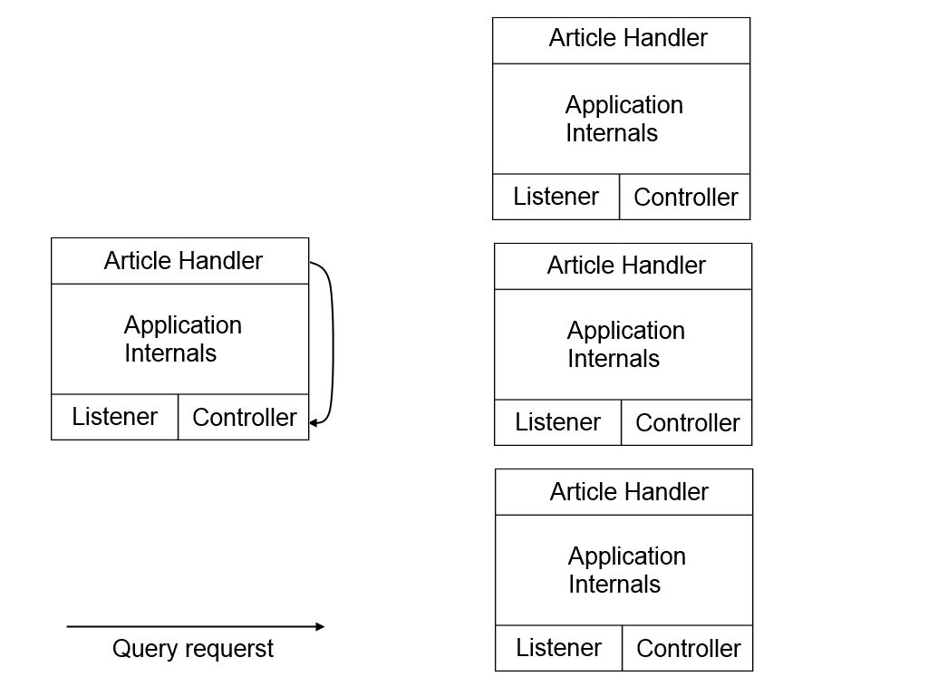
Article Querying

Slide 27
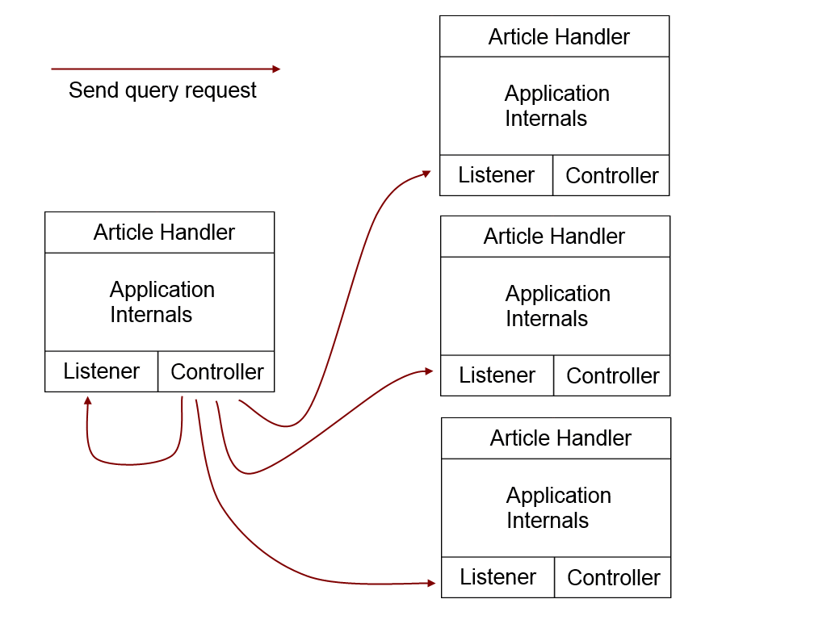
Article Querying

Slide 28
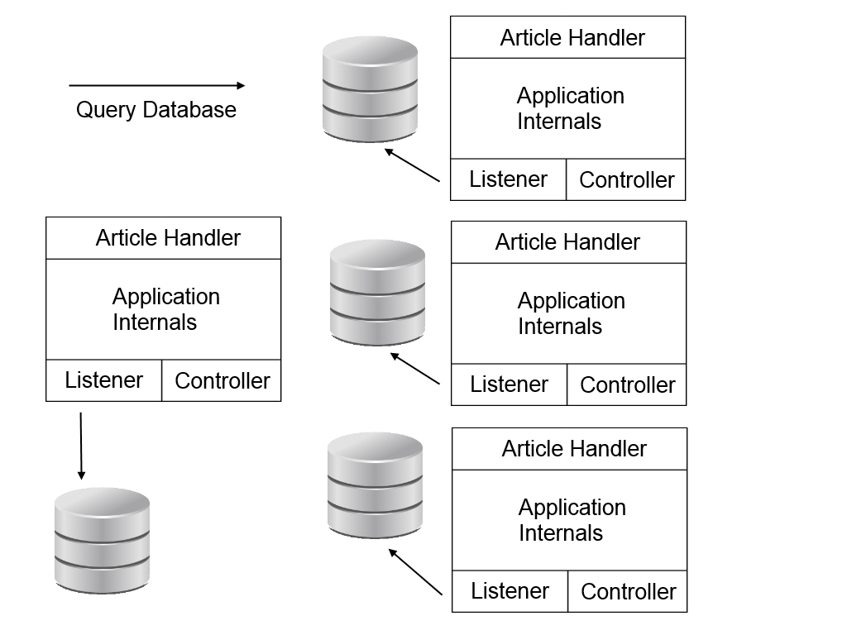
Article Querying

Slide 29
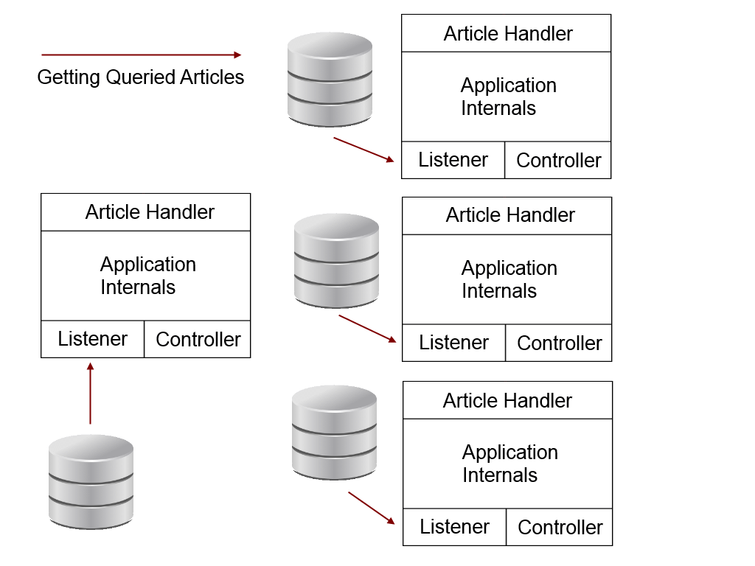
Article Querying

Slide 30
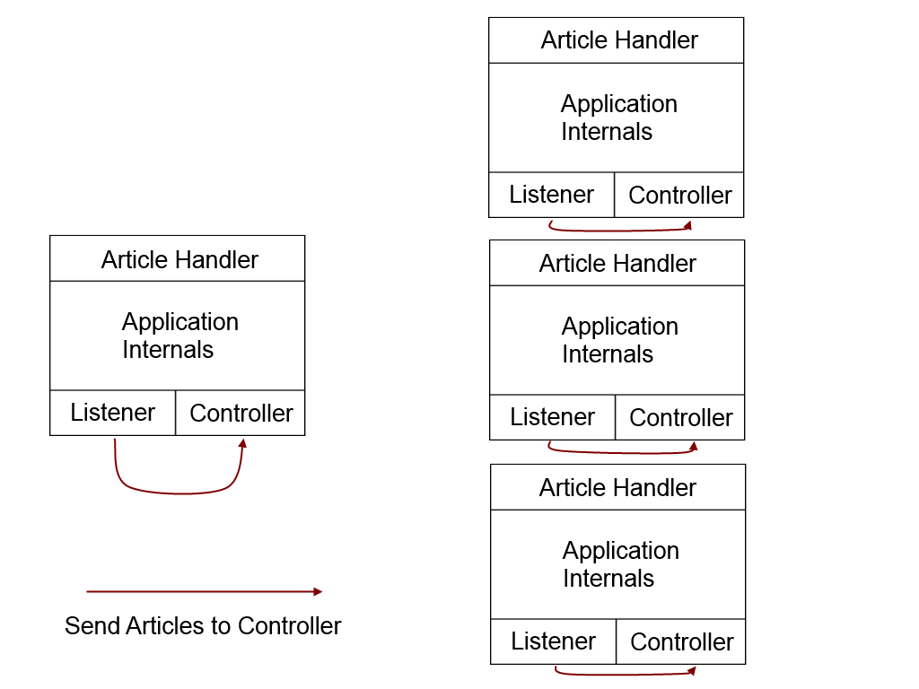
Article Querying

Slide 31
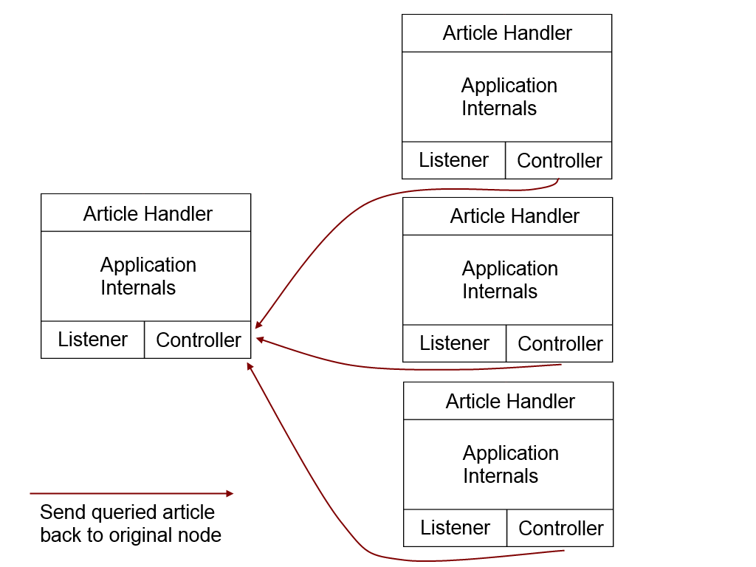
Article Querying

Slide 32
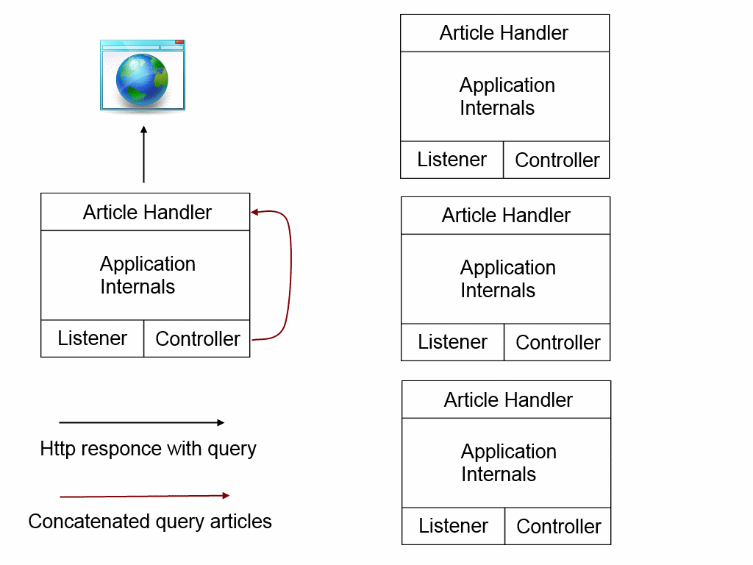
Article Querying

Slide 33
Bibliography
Veldstra, Hassy. Welcome to erlang. http://veldstra.org/whyerlang/
JRL. Stackoverflow. http://stackoverflow.com/questions/1636455/where-is-erlang-used-and-why
Lopacki, Leslaw. ERLANG Functional Programming in industry http://www.slideshare.net/Dominque23/industrial-use-of-erlang
Lomax, Keith. Quora http://www.quora.com/Where-and-how-is-Erlang-used-in-the-finance-industry
Romain Slootmaekers http://blog.incubaid.com/2012/03/28/the-game-of-distributed-systems-programming-which-level-are-you/
Alexander Bondarenko http://hackage.haskell.org/packages/archive/distributed-process-p2p/0.1.0.0/doc/html/Control-Distributed-Backend-P2P.html

Slide 34
Demo & Source code & Contact Details
Email: hchiao@student.unimelb.edu.au
Source: https://bitbucket.org/coolhhc/p2pmedia-yesod1.2

