Slide 1
Using Triple Pattern Fragments to Enable
Streaming of Top-K Shortest Paths via the Web
Laurens De Vocht
Ruben Verborgh, Erik Mannens and Rik Van de Walle

Slide 2
Introduction
Challenge
Trade-offs
Scalability
Conclusions
Notes:
Zwarte slide met structuur die blijft terugkomen

Slide 3
Introduction
Challenge
Trade-offs
Scalability
Conclusions
Notes:
Zwarte slide met structuur die blijft terugkomen

Slide 4

?
S
E
Notes:
What is there between a start node S and a destination node E?

Slide 5
Introduction
Minimal Cost Path
Shortest Path

Slide 6
Introduction
Both are using Triple Pattern Fragments (TPF’s)
(s, p, o) -> { metadata: { count: … }, triples: { … } }
Essential the core of an expand(s) function:
(s, ?p, ?o)

Slide 7
Introduction
Minimal Cost Path
Shortest Path

Slide 8
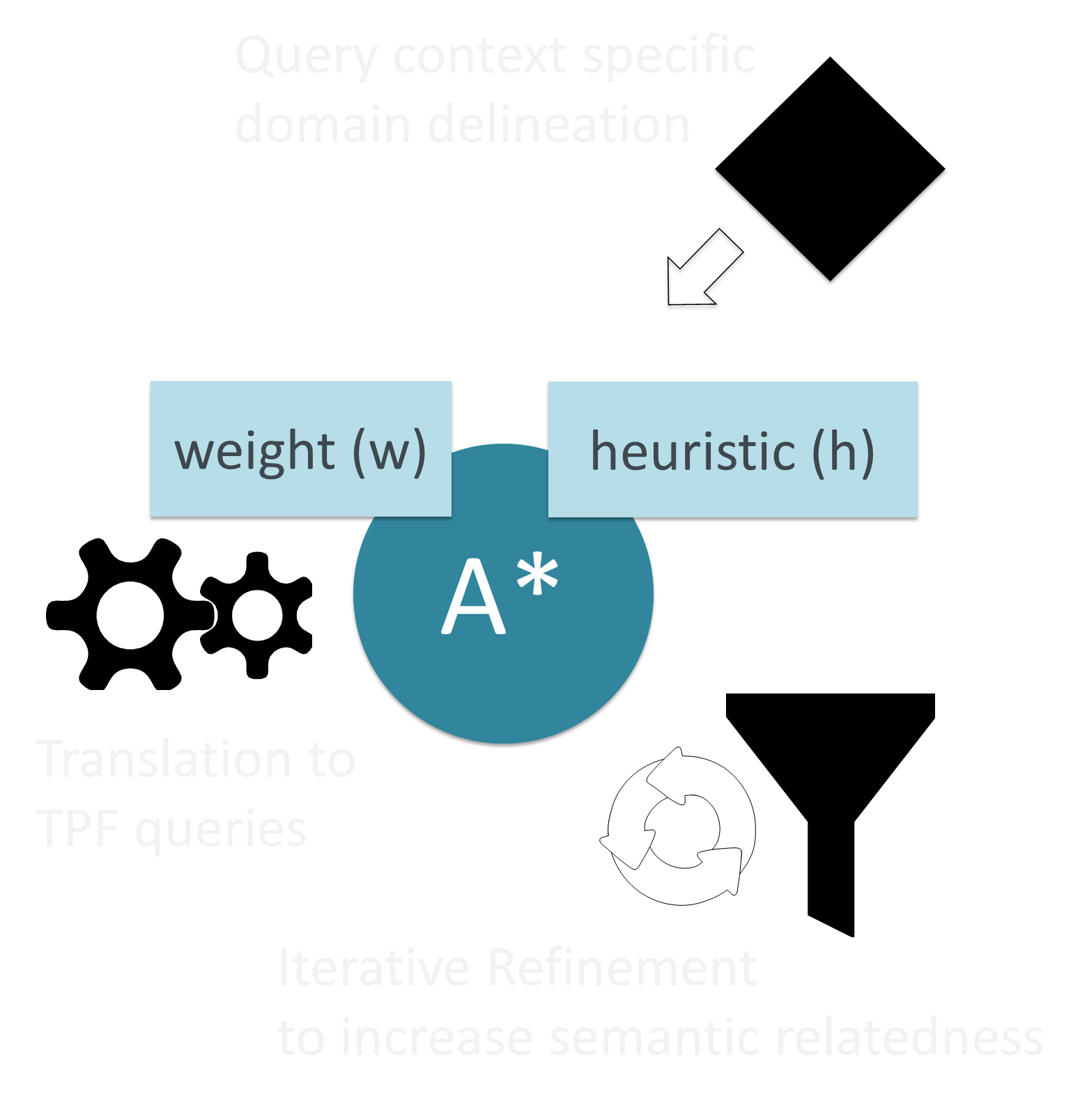
Minimal Cost
Notes:
Note:
What is minimal cost?
heuristic
weight

Slide 9
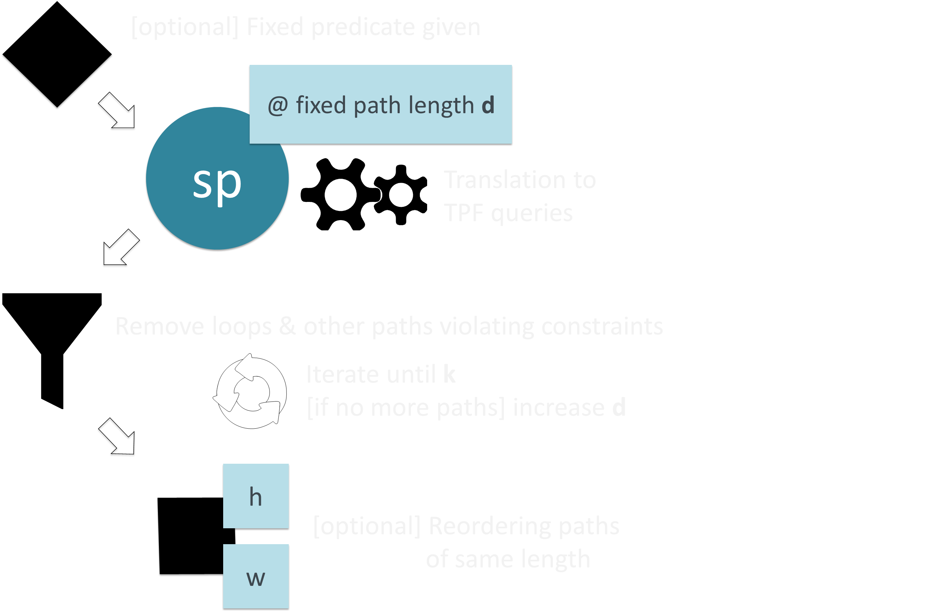
Shortest
Notes:
Note:
What is shortest?

Slide 10
Introduction
Challenge
Trade-offs
Scalability
Conclusions
Notes:
Zwarte slide met structuur die blijft terugkomen

Slide 11
This challenge evolves around the development and deployment of a system that returns a specific number of ordered paths between two nodes in a given RDF graph.
http://2016.eswc-conferences.org/top-k-shortest-path-large-typed-rdf-graphs-challenge

Slide 12
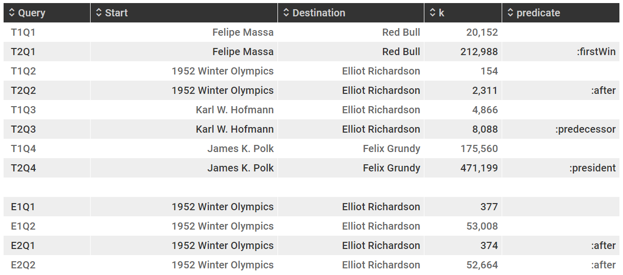
Challenge
T1Q2 and T2Q2 vs. ExQx:
Training Data (+- 10M triples), Evaluation Data (+- 100M triples)
Subset of DBpedia
K = no. of paths requested
S
E
K

Slide 13
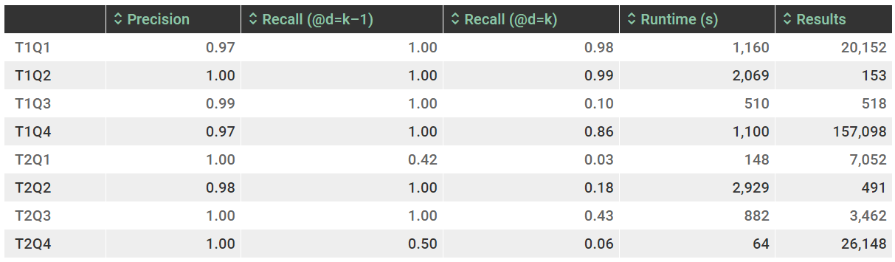
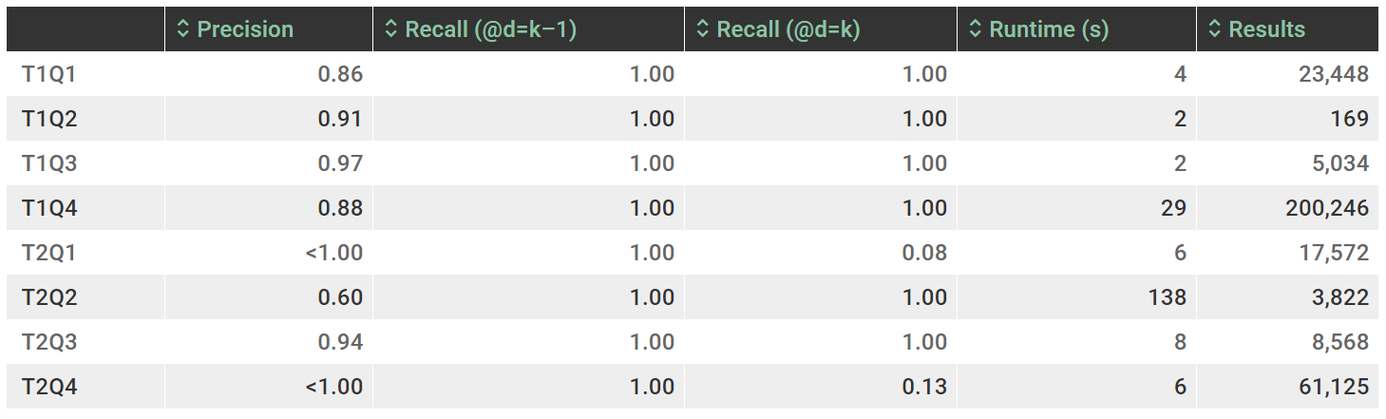
Challenge
n = max. path length @K results
d = path length (distance)
k = total paths retrieved
K = no. of paths requested
(@k)
(@d=n - 1)
(@d=n)
(k)
S
D
TPF
(@k)
(@d=n - 1)
(@d=n)
(k)
SPARQL
Notes:
Explain it is not performance focused -> why is 100x slower acceptable? Streaming, federation, ease of use.

Slide 14
Challenge
Streaming Behavior T1Q3
Notes:
Progression of the results streaming in task 1, query 3. At k = 100 and
300 < k < 350 the streaming seems to pause and from 500 on the streaming
speed severely decreases until halting or at least taking a really long time for each next result at k = 518.
At these points path length d increases.
Why? Looking into that ☺

Slide 15
Introduction
Challenge
Trade-offs
Scalability
Conclusions
Notes:
Zwarte slide met structuur die blijft terugkomen

Slide 16

TRADE-OFFS
Each top-k query is compact and has a similar structure,
but TPF’s not able to benefit from specialized indexes
available in for example triple stores;
Has currently a much slower performance (10 – 100x).

Slide 17
TRADE-OFFS
Useful when centralization of the data is not possible or desired; low server cost where TPFs perform good in case of federation as well.
TPF allows shifting from pure speed optimization to other metrics.
It would for example be possible to generate and pre-cache many of the fragments, leading to a better cost/performance ratio.
Shows the versatility of TPFs and their applications.
Stream top-k shortest paths in NodeJS web apps from TPF endpoints.

Slide 18
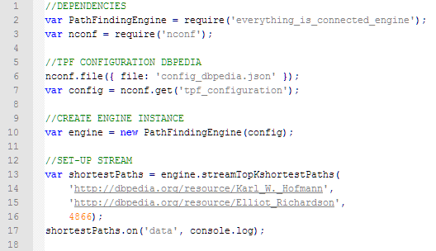
SAMPLE CODE
Example how to integrate in nodejs web application.

Slide 19


Slide 20
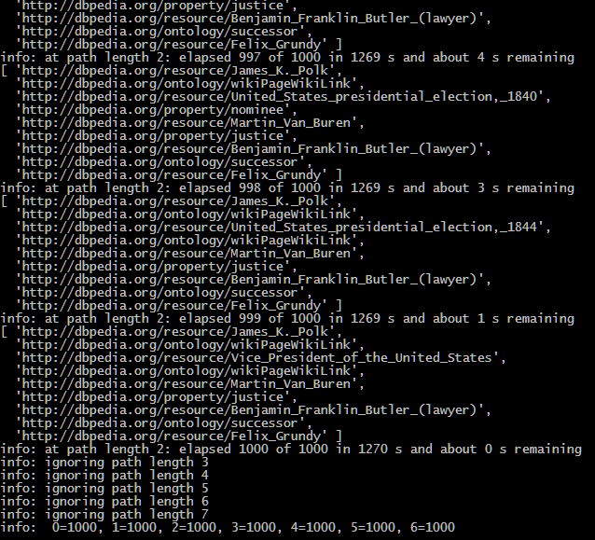

Slide 21
Introduction
Challenge
Trade-offs
Scalability
Conclusions
Notes:
Zwarte slide met structuur die blijft terugkomen

Slide 22
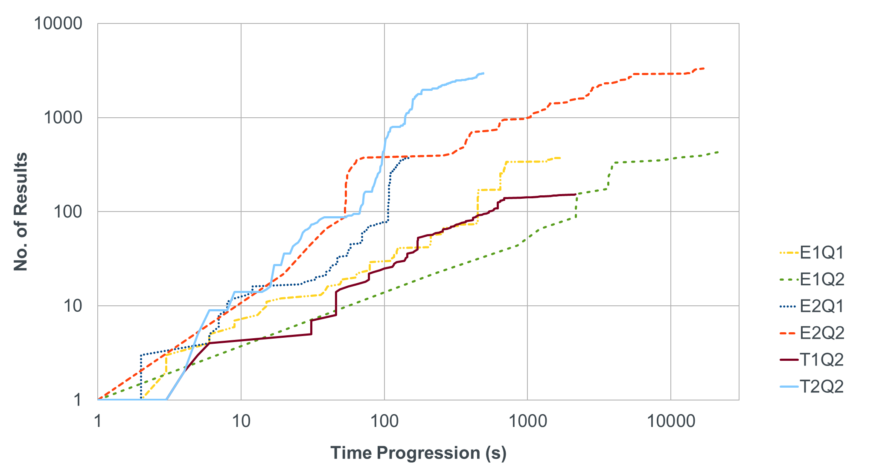
SCALABILITY
fixed predicate
no fixed predicate

Slide 23
Introduction
Challenge
Trade-offs
Scalability
Conclusions
Notes:
Zwarte slide met structuur die blijft terugkomen

Slide 24
CONCLUSIONS
Higher precision but lower recall compared to SPARQL queries.
Faster results when queries have a fixed predicate.
No evidence increased dataset size (x10) impacts performance.
Number of paths requested K has biggest impact on performance
(the higher path length d = n (@K ) the more fragments streamed).
Notes:
Finding each next path costs more and more

Slide 25
NEXT STEPS
Look into why certain path queries stop streaming early
Investigate the impact of caching.
Look beyond TPF’s and their count estimates,
other type of fragments might improve performance.
Allow (re)ordering of paths having the same length d.

Slide 26
CONTACT DETAILS
laurens.devocht@ugent.be
@laurens_d_v
http://slideshare.net/laurensdv

