Slide 1
Top-k Shortest Paths in Directed Labeled Multigraphs Sven Hertling, Markus Schröder, Christian Jilek, Andreas Dengel
Top-K Shortest Path in
Large Typed RDF Graphs
Challenge
ESWC 2016

Slide 2
Motivation
?
dbr:Felipe_Massa
dbr:Red_Bull
shortest path is obvious link between two resources
subsequent shortest paths: maybe even more interesting relationships
approach based on common top-k shortest path algorithm

Slide 3
Outline
top-k shortest path introduction
approach based on eppstein algorithm
evaluation based on challenge training and test set
SPARQL implementation
conclusion
intro | approach | eval | sparql | conclusion

Slide 4
Introduction
finding not only shortest path but also subsequent ones
based on knowledge represented as RDF
additional constraints
a path is valid only if it contains unique triples
but can have multiply visited vertices
common algorithms cannot be applied
intro | approach | eval | sparql | conclusion

Slide 5
Introduction
p2
u1
u2
p1
p8
p3
u6
P
A
P
p7
B
u3
p4
p6
p5
u4
u5
intro | approach | eval | sparql | conclusion

Slide 6
Introduction
p2
multiply visited u3
but used each triple
(vertex, edge, vertex)
only once
u1
u2
p1
p8
p3
u6
P
A
P
p7
B
u3
p4
p6
p5
u4
u5
intro | approach | eval | sparql | conclusion

Slide 7
Introduction
p2
multiply used triple
(u3, p4, u4)
u1
u2
p1
p8
p3
u6
P
A
P
p7
B
u3
p4
p6
p5
u4
u5
intro | approach | eval | sparql | conclusion

Slide 8
Introduction
p2
thus common algorithms (e.g. Dijkstra, Yen, Eppstein, …) cannot be applied without further ado
u1
u2
p1
p8
p3
u6
P
A
P
p7
B
u3
p4
p6
p5
u4
u5
two tasks in ESWC top-k shortest path challenge:
top-k shortest valid paths
every path should have the edge P as the outgoing edge of src or the incoming edge of dst
intro | approach | eval | sparql | conclusion

Slide 9
Approach
p2
u1
u2
based on Eppstein algorithm
(k shortest path algorithm
with loops)
core idea: make a heap where elements are complete paths
p1
p8
p3
u6
P
A
P
p7
B
u3
p4
p6
p5
u4
u5
intro | approach | eval | sparql | conclusion

Slide 10
Approach
Shortest Path Tree (T)
Sidetracks (G – T)
p2
u1
u2
compute single destination shortest path tree T (e.g. Dijkstra)
all other edges are called sidetracks (G – T)
p1
p8
p3
u6
P
A
P
p7
B
u3
p4
p6
p5
u4
u5
intro | approach | eval | sparql | conclusion

Slide 11
Approach
Shortest Path Tree (T)
Sidetracks (G – T)
p2
u1
u2
now it is possible to “activate” one or more sidetracks
a complete path is represented by a set of activated sidetracks
p1
p8
p3
u6
P
A
P
p7
B
u3
p4
p6
p5
u4
u5
a path is built up by using activated sidetracks or otherwise shortest path
e.g. the empty set corresponds to (A, P, u3, p7,B)
set {p3} corresponds to (A, p3, u6, P, B)
intro | approach | eval | sparql | conclusion

Slide 12
Approach
Shortest Path Tree (T)
Sidetracks (G – T)
p2
u1
u2
build a graph P(G) based on heaps which orders all sidestracks on the shortest path from v to the destination
p1
p8
p3
u6
P
$$H_{G}(v)$$
A
P
p7
B
u3
p4
p6
p5
u4
u5
$$init$$
…
A, P, u3, p7, B
…
A
cross edge
p3
A, p3, u6, P, B
A
u6
$$H_{G}(A)$$
heap edge
A, P, u3, p4, u4,
p5, u5, p6,
u3, p7, B
p4
p1
A, p1, u1, p2,
u2, p8, B
u3
u4
A
u1
$$H_{G}(u4)$$
p4
pruning because of duplicate sidetracks
u3
u4
intro | approach | eval | sparql | conclusion

Slide 13
Approach
Shortest Path Tree (T)
Sidetracks (G – T)
p2
u1
u2
special case:
assume p4 and new edge p4’ are activated
cycle u3, u4, u5 used twice
thus edge p5 used twice
in P(G) we will not detect it because it only contains sidetracks
thus when extending P(G) build path and check if the path is valid
p1
p8
p3
u6
P
A
P
p7
B
u3
p4‘
p4
p6
p5
u4
u5
intro | approach | eval | sparql | conclusion

Slide 14
Approach
Shortest Path Tree (T)
Sidetracks (G – T)
p2
u1
u2
special case:
assume new edge p4’, p5’ and p6’
assume p4 and p4’ are activated
we cannot prune P(G) because p5’ and p6’ can be activated in the future
p1
p8
p3
u6
P
A
P
p7
B
u3
p4‘
p6‘
p4
p6
p5
u4
u5
p5‘
intro | approach | eval | sparql | conclusion

Slide 15
Approach
Shortest Path Tree (T)
Sidetracks (G – T)
p2
u1
u2
task two: all paths starting or ending on P
paths starting with P
new dummy vertex A’ is created
all P-edges starting in A are duplicated
run modified Eppstein with A’ as the starting node
p1
p8
p3
u6
P
A
P
p7
B
u3
P
A‘
p4
p6
p5
u4
u5
intro | approach | eval | sparql | conclusion

Slide 16
Approach
Shortest Path Tree (T)
Sidetracks (G – T)
p2
u1
u2
task two: all paths starting or ending on P
paths ending with P
invert every edge
execute same procedure
merge results
p1
p8
p3
u6
P
A
P
p7
B
u3
p4
p6
p5
u4
u5
intro | approach | eval | sparql | conclusion

Slide 17
Approach
p9
p2
u1
u2
why not “deleting” p1 and p3?
what about p9?
(A, u3, B, A, u6, B) is also valid
a shortest path can also contain the target vertex in the middle
when visiting A the second time the restriction is cancelled
p1
p8
p3
u6
P
A
P
p7
B
u3
p4
p6
p5
u4
u5
intro | approach | eval | sparql | conclusion

Slide 18
Evaluation
based on the training set of the ESWC Top-k Shortest Path Challenge
successfully solved all queries
training set (10% DBpedia SPARQL Benchmark)
9,996,907 triples (394,085 multiple edges, 407 reflexive)
7,598,913 of them being literal statements
evaluation set (100% DBpedia SPARQL Benchmark)
110,621,287 triples
intro | approach | eval | sparql | conclusion

Slide 19
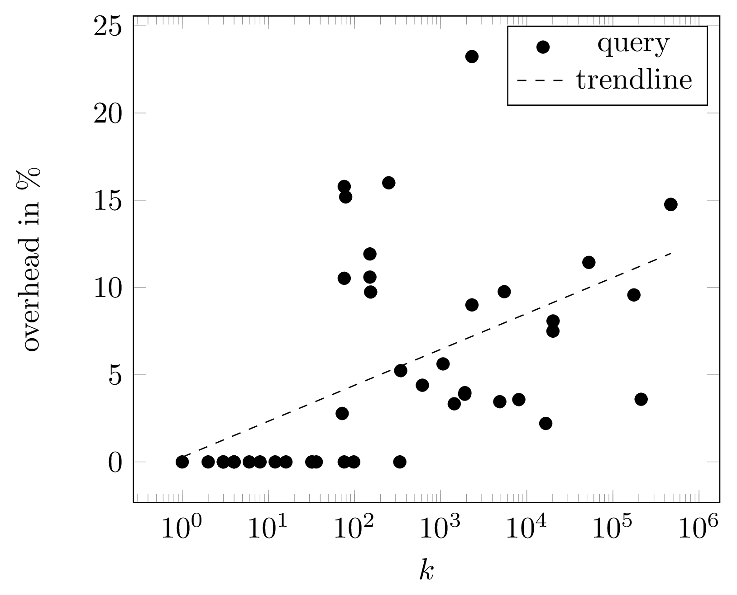
Evaluation
the relation between k and the overhead of all queries
high k results in a high overhead since more potentially invalid paths are found
intro | approach | eval | sparql | conclusion

Slide 20
SPARQL
we implemented an add-on for
FUSEKI – a SPARQL endpoint
with this add-on, k shortest paths can be retrived
example query:
SELECT *
WHERE {
dbr:Felipe_Massa !:* dbr:Red_Bull.
FILTER(?r1 = dbp:after).
}
LIMIT 2
intro | approach | eval | sparql | conclusion

Slide 21
SPARQL
example result:
?length | ?r0 | ?r1 | ?r2 | ?r3 | ?r4 | ?r5 | ?r6
7 | dbr:Felipe_Massa | dbp:after | dbr:Robert _Kubica | dbp:first Win | dbr:2008 _Canadian _Grand _Prix | dbp:third Team | dbr:Red _Bull
7 | dbr:Felipe_Massa | dbp:after | dbr:Robert _Kubica | dbo:first Win | dbr:2008 _Canadian _Grand _Prix | dbp:third Team | dbr:Red _Bull
intro | approach | eval | sparql | conclusion

Slide 22
Conclusion
approach for finding top-k shortest paths based on Eppstein’s algorithm which induces only moderate overhead
successfully solved all tasks given in the ESWC 2016 Top-k Shortest Path Challenge
in future versions we intend to lazily build heaps and try to predict invalid paths earlier
intro | approach | eval | sparql | conclusion

Slide 23
Thank you
questions, opinions, suggestions, discussions
?

Slide 24
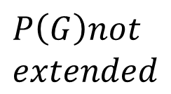
$$\frac{(iterations−k)}{k}$$
$$P\left(G\right)not$$
$$extended$$
Id | k | Iterations | Overhead | Time (ms) | Pruned | |V P(G)| | |H|
1 | 8 | 8 | 0.00% | 6531 | 0 | 83 | 15
1 | 344 | 362 | 5.23% | 6663 | 6 | 4401 | 715
1 | 1068 | 1128 | 5.61% | 6833 | 12 | 16408 | 2296
1 | 20152 | 21663 | 7.49% | 12404 | 407 | 293527 | 43701
2 | 3 | 3 | 0.00% | 5528 | 0 | 64 | 6
2 | 4 | 4 | 0.00% | 5662 | 0 | 80 | 8
2 | 79 | 91 | 15.18% | 5783 | 4 | 1702 | 174
2 | 154 | 169 | 9.74% | 5908 | 4 | 3193 | 336
3 | 36 | 36 | 0.00% | 5785 | 0 | 64 | 6
3 | 336 | 336 | 0.00% | 5932 | 0 | 80 | 8
3 | 4866 | 5034 | 3.45% | 8147 | 4 | 1702 | 174
4 | 2 | 2 | 0.00% | 6137 | 0 | 78 | 4
4 | 16 | 16 | 0.00% | 6230 | 0 | 524 | 34
4 | 250 | 254 | 1.60% | 6416 | 0 | 7389 | 515
4 | 1906 | 1980 | 3.88% | 8393 | 34 | 58426 | 3984
4 | 20224 | 21858 | 8.07% | 13980 | 678 | 619359 | 42879
4 | 175560 | 192367 | 9.57% | 45785 | 7592 | 5628758 | 380839

