Slide 1

DNAseq analysis
Bioinformatics Analysis Team
McGill University and Genome Quebec Innovation Center
bioinformatics.service@mail.mcgill.ca

Slide 2
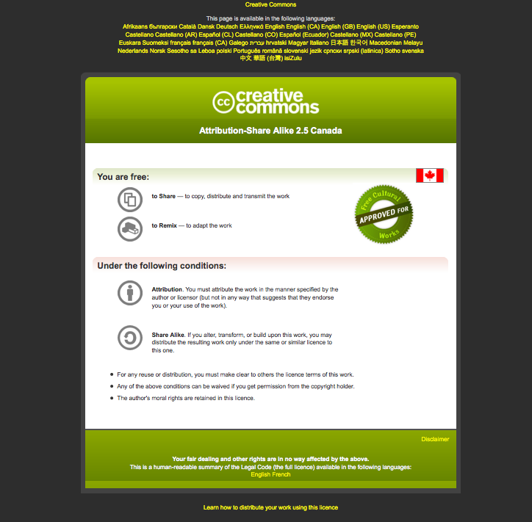
Module #: Title of Module
2

Slide 3
What is DNAseq ?
DNA sequencing is the process of determining the precise order of nucleotides within a DNA molecule.
The advent of rapid DNA sequencing methods has greatly accelerated biological and medical research and discovery.

Slide 4
Why dnaSeq ?
Whole genome sequencing:
  Whole genome SNV detection
  Structural variant
  Capture the regulatory region information
  Cancer analysis
  De novo genome assembly
Whole exome sequencing:
  Cheaper
  Capture the coding region information
  Rare diseases analysis

Slide 5
What the DNAseq problem is about ?
Strings of 100 to ≈1kb letters
Puzzle of 3,000,000,000 letters
Usually have 120,000,000,000 letters you need to fit
Many pieces don’t fit :
  sequencing error/SNP/Structural variant
Many pieces fit in many places:
  Low complexity region/microsatellite/repeat

Slide 6
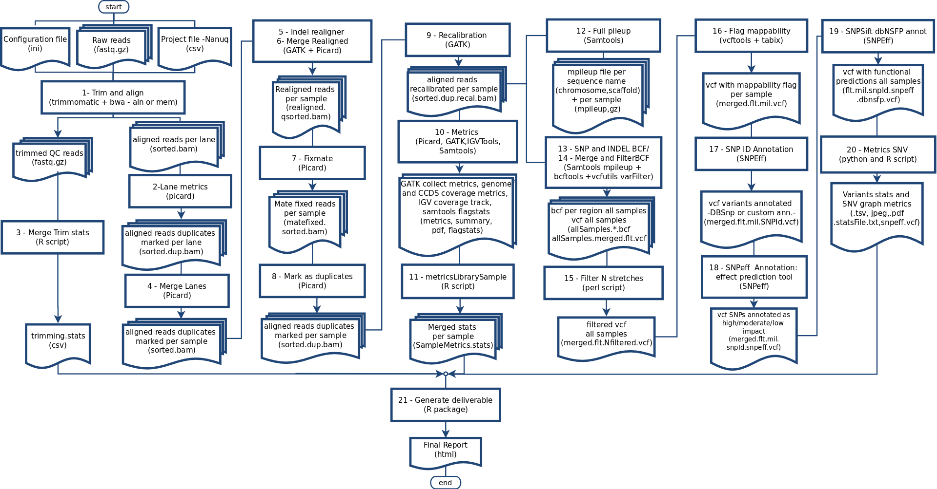
DNAseq overview

Slide 7
DNAseq: Input Data

Slide 8
Input Data: FASTQ
End 1
End 2
Sample1_R1.fastq.gz
Sample1_R2.fastq.gz
Sample2_R1.fastq.gz
Sample_R2.fastq.gz
Each sample will generate between 5Gb (100x WES) to 300Gb (100x WGS) of data

Slide 9
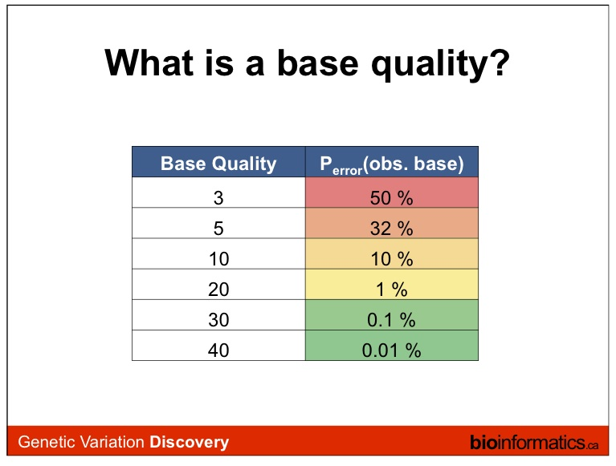
Q = -10 log_10 (p)
Where Q is the quality and p is the probability of the base being incorrect.

Slide 10
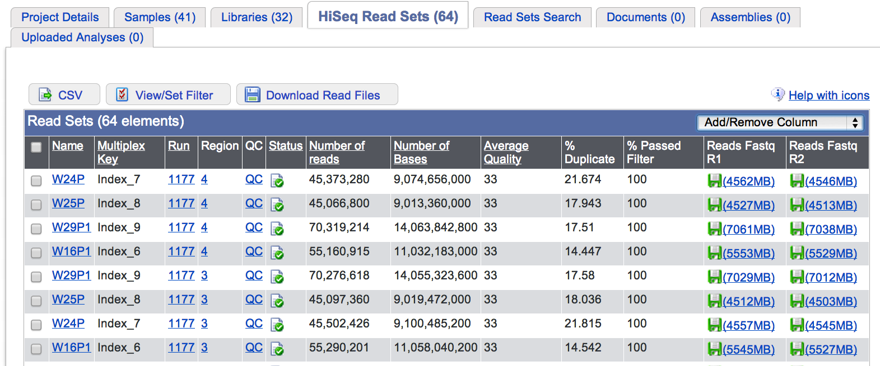
QC of raw sequences

Slide 11
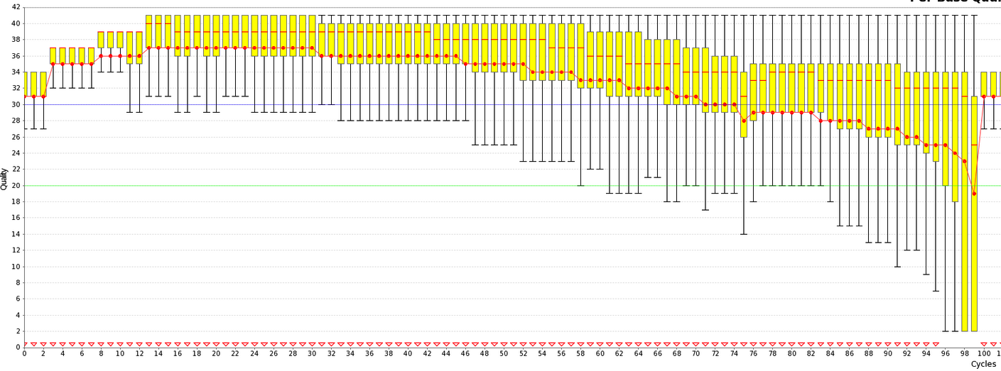
QC of raw sequences
low qualtity bases can bias subsequent anlaysis
(i.e, SNP and SV calling, …)

Slide 12
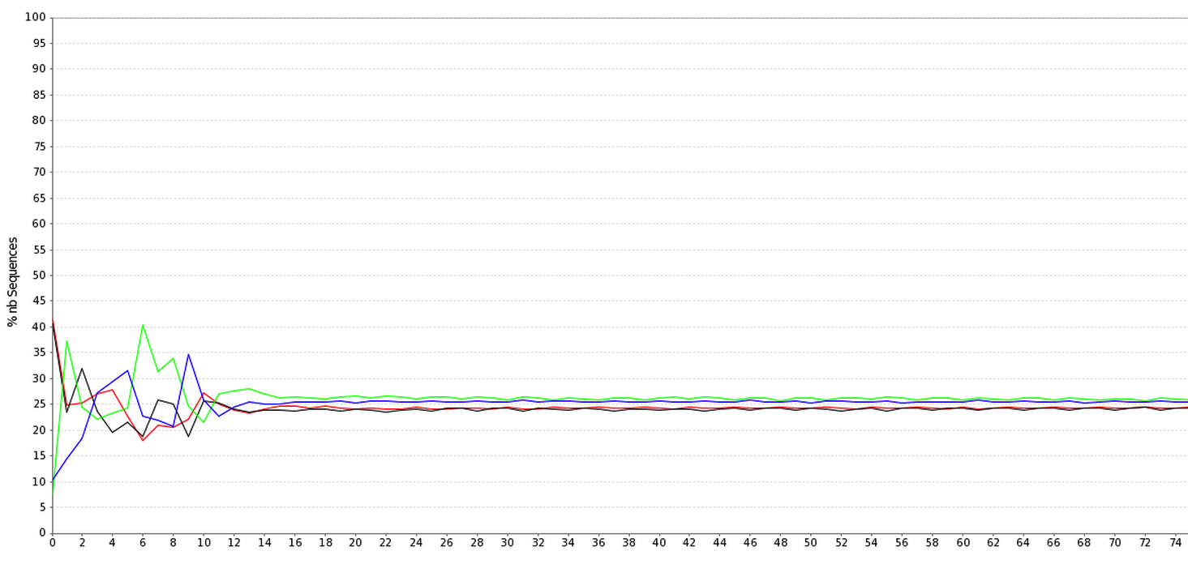
QC of raw sequences
Positional Base-Content

Slide 13
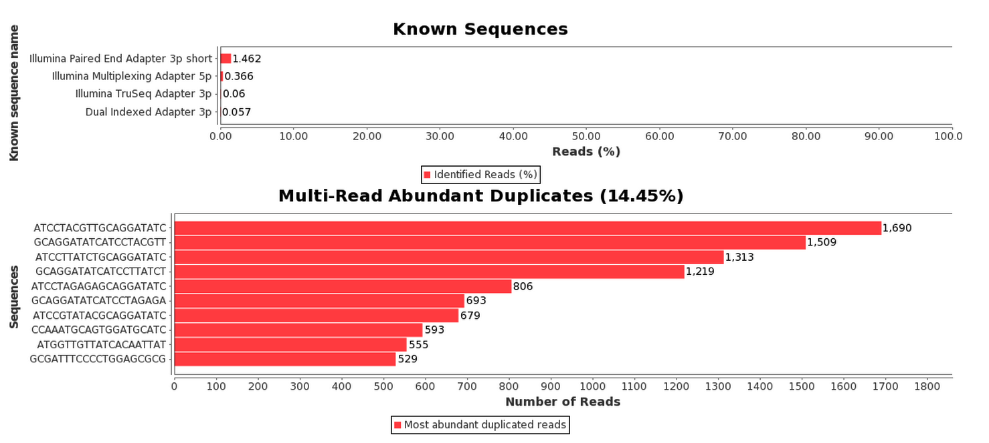
QC of raw sequences

Slide 14
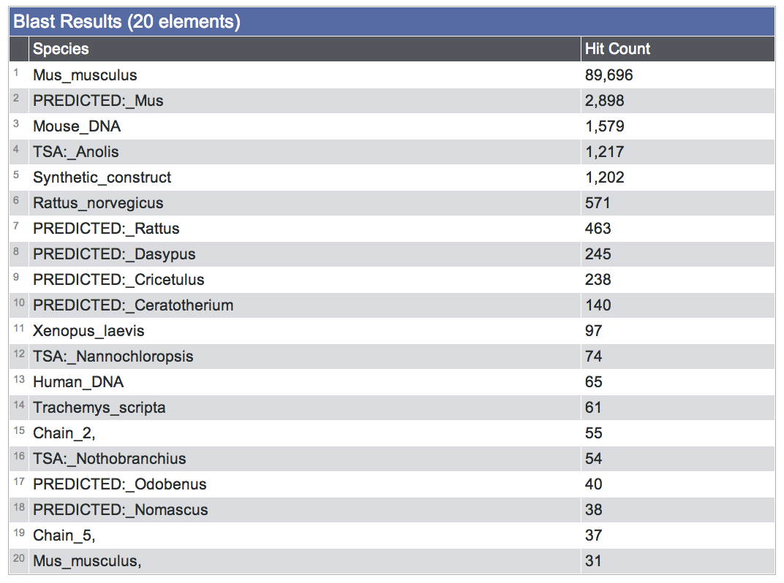
QC of raw sequences
Species composition (via BLAST)

Slide 15
DNA-Seq: Trimming and aligning

Slide 16

Read Filtering
Clip Illumina adapters:
Trim trailing quality < 30
Filter for read length ≥ 32 bp
usadellab.org

Slide 17
Assembly vs. Mapping
mapping
all vs reference
Reference
reads
contig1
contig2
assembly
all vs all

Slide 18
RNA-seq: Assembly vs Mapping
Reference-based mapping
Ref. Genome
DNA-seq
reads
De novo assembly
contig1
contig2

Slide 19
Read Mapping
Mapping problem is challenging:
  Need to map millions of short reads to a genome
  Genome = text with billons of letters
  Many mapping locations possible
  NOT exact matching: sequencing errors and biological variants (substitutions, insertions, deletions, splicing)
Clever use of the Burrows-Wheeler Transform increases speed and reduces memory footprint
Used mapper: BWA
Other mappers: Bowtie, STAR, GEM, etc.

Slide 20
SAM/BAM
Sample1.bam
between 10Gb ot 500Gb each bam
Sample2.bam
SRR013667.1 99 19 8882171 60 76M = 8882214 119
NCCAGCAGCCATAACTGGAATGGGAAATAAACACTATGTTCAAAG
Used to store alignments
SAM = text, BAM = binary
SRR013667.1 99 19 8882171 60 76M = 8882214 119
NCCAGCAGCCATAACTGGAATGGGAAATAAACACTATGTTCAAAGCAGA
#>A@BABAAAAADDEGCEFDHDEDBCFDBCDBCBDCEACB>AC@CDB@>
…
Read name
Flag
Reference Position
CIGAR
Mate Position
Bases
Base Qualities
SAM: Sequence Alignment/Map format

Slide 21

The BAM/SAM format
samtools.sourceforge.net
picard.sourceforge.net
Sort, View, Index, Statistics, Etc.
$ samtools flagstat C1.bam
110247820 + 0 in total (QC-passed reads + QC-failed reads)
0 + 0 duplicates
110247820 + 0 mapped (100.00%:nan%)
110247820 + 0 paired in sequencing
55137592 + 0 read1
55110228 + 0 read2
93772158 + 0 properly paired (85.06%:nan%)
106460688 + 0 with itself and mate mapped
3787132 + 0 singletons (3.44%:nan%)
1962254 + 0 with mate mapped to a different chr
738766 + 0 with mate mapped to a different chr (mapQ>=5)
$

Slide 22
DNA-Seq: metrics

Slide 23
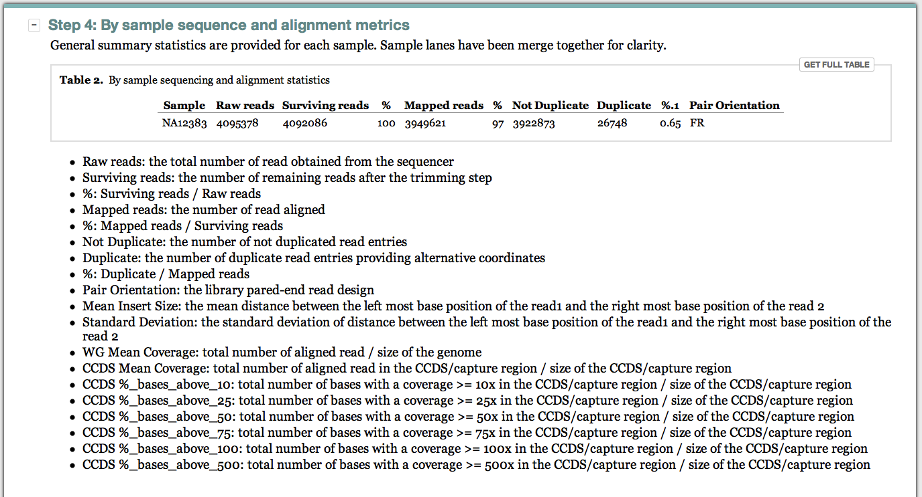
Included metrics
Metrics are collected form the output of Trimmomatic, Samtools and Picard softwares

Slide 24
DNA-Seq: Alignment refinement

Slide 25
Local indel realignment
Primary alignment with BWA bio-bwa.sourceforge.net
Local re-alignment around indels with GATK
Possible mate inconsistency are fixed using Fixmate
image: broadinstitute.org/gatk

Slide 26
Duplicates and recalibration
Mark duplicates with Picard
Base Quality Score Recalibration GATK
Example Bias in the qualities reported depending of the nucleotide context
image: broadinstitute.org/gatk

Slide 27
DNA-Seq: SNV calling

Slide 28
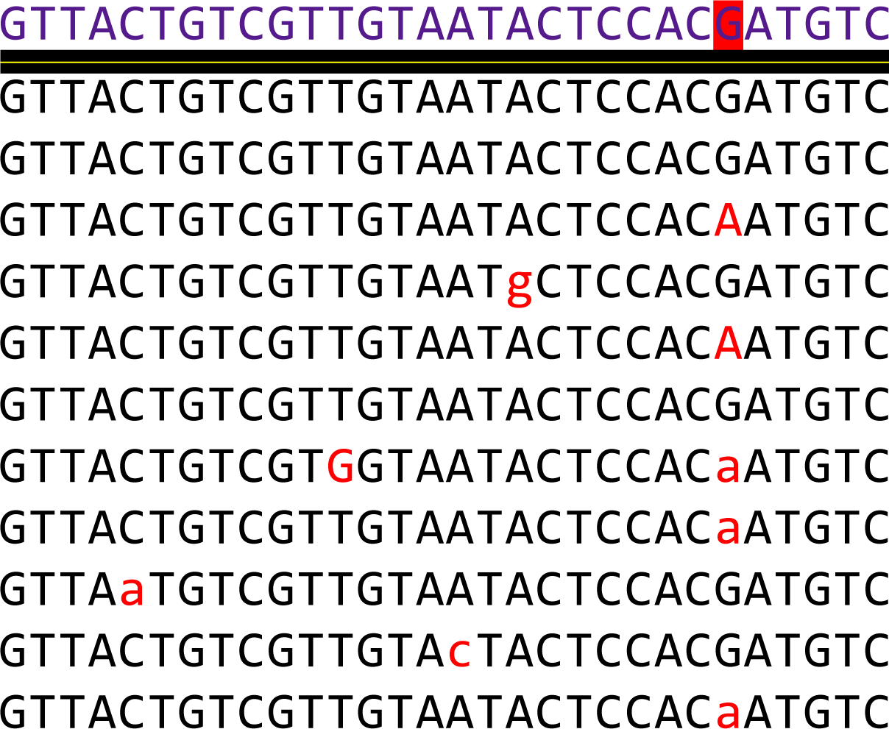
Single Nucleotide Variant calling
Aim: differentiate real SNPs from sequencing errors
An accurate SNP discovery is closely linked with a good base quality and a sufficient depth of coverage
sequencing errors
SNP

Slide 29
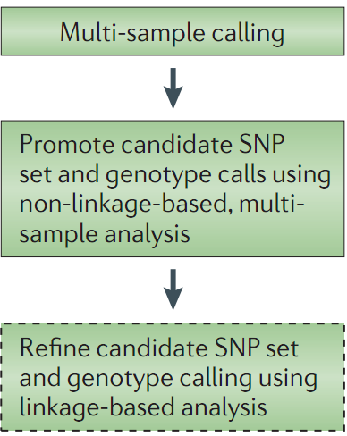
SNP and genotype calling workflow
Variants from multiple samples are called simultaneously using the mpileUp method from samtools and quality filtered using bcftools
Bayesian apporachs
MLE apporachs
Nielsen et al June 2011

Slide 30
The variant format : vcf
Variant Call Format
Column FORMAT defines “:”
separated values
GT = Genotype
DP = depth
…
vcftools.sourceforge.net/specs.html

Slide 31
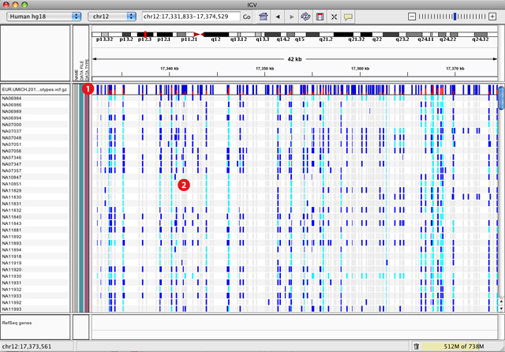
VCF visualization in IGV
broadinstitute.org/igv/viewing_vcf_files

Slide 32
DNA-Seq: SNV annotation and metrics

Slide 33
Variant annotation
Hypo- or hyper-mappabilty flag
  Mark SNV in low confidence regions
dbSNP [SnpSift]
  Mark already known variant
Variant effects [SnpEff]
  predict the effects of variants on genes (such as amino acid changes)
dbNSFP [SnpSift]
  Functional annotations of the change
Cosmic[SnpSift]
  Known somatic mutations

Slide 34
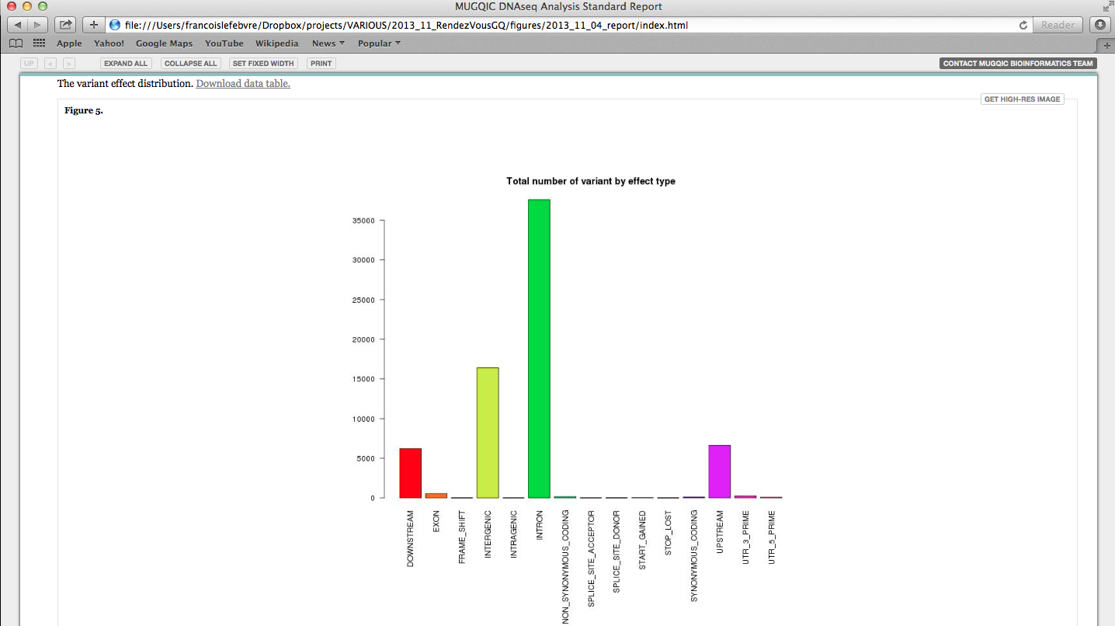
SNV statistics
Statistics are generated from the SNPeff stats outputs
Example of one of the SNv metrics graph

Slide 35
DNA-Seq: Generate report

Slide 36
Home-made Rscript
Generate report
  Noozle-based html report which describe the entire analysis and provide QC, summary statistics as well as the entire set of results
Files generated:
  index.html, links to detailed statistics and plots
For examples of report generated while using our pipeline please visit our website

