Slide 1

RNAseq analysis
Bioinformatics Analysis Team
McGill University and Genome Quebec Innovation Center
bioinformatics.service@mail.mcgill.ca

Slide 2

Module #: Title of Module
2

Slide 3
Why sequence RNA?
Functional studies
  Genome may be constant but experimental conditions have pronounced effects on gene expression
Some molecular features can only be observed at the RNA level
  Alternative isoforms, fusion transcripts, RNA editing
Interpreting mutations that do not have an obvious effect on protein sequence
  ‘Regulatory’ mutations
Prioritizing protein coding somatic mutations (often heterozygous)
Modified from Bionformatics.ca

Slide 4
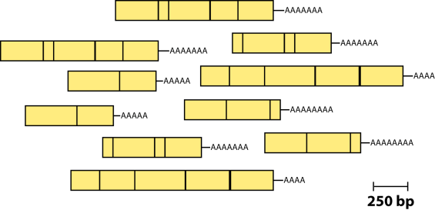
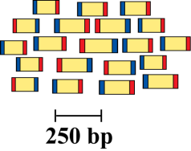
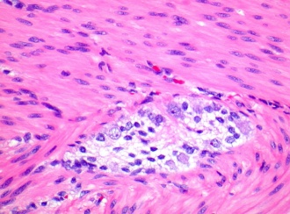
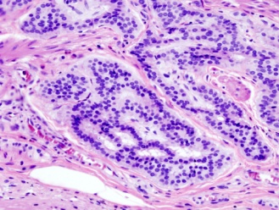
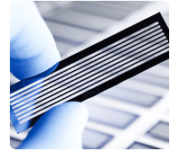
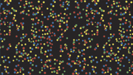
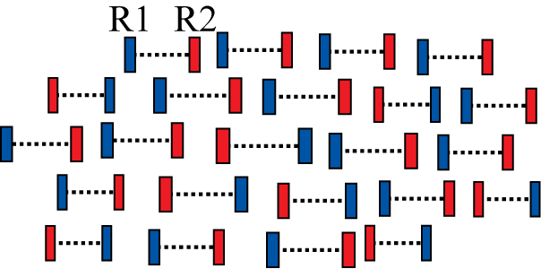
RNA-seq
Isolate RNAs
Generate cDNA, fragment, size select, add linkers
Samples of interest
Sequence ends
Condition 1
(normal colon)
Condition 2
(colon tumor)
100s of millions of paired reads
10s of billions bases of sequence

Slide 5
RNA-seq – Applications
Gene expression and differential expression
Transcript discovery
SNV, RNA-editing events, variant validation
Allele specific expression
Gene fusion events detection
Genome annotation and assembly
etc ...

Slide 6
RNAseq Challenges
RNAs consist of small exons that may be separated by large introns
  Mapping splice-reads to the genome is challenging
  Ribosomal and mitochondrial genes are misleading
RNAs come in a wide range of sizes
  Small RNAs must be captured separately
RNA is fragile and easily degraded
  Low quality material can bias the data
Modified from Bionformatics.ca

Slide 7
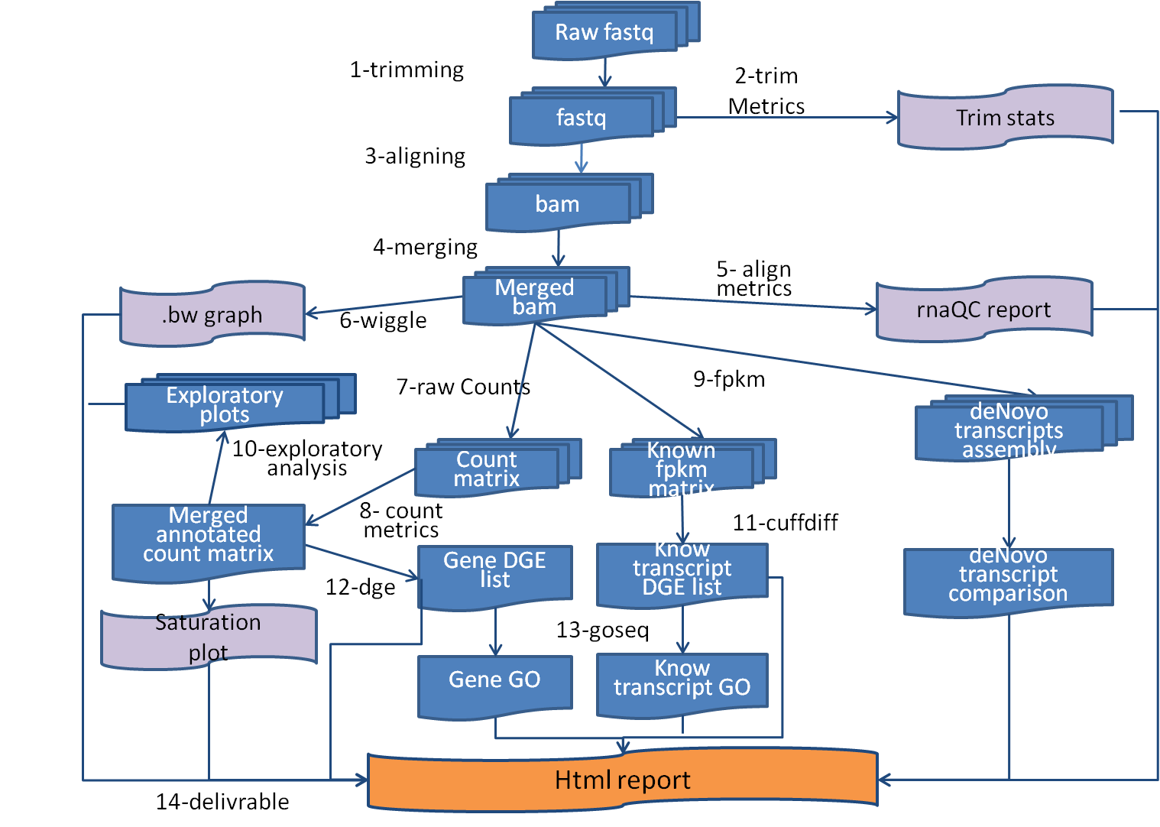
RNA-Seq: Overview

Slide 8
RNA-Seq: Input Data

Slide 9
Input Data: FASTQ
End 1
End 2
Control1_R1.fastq.gz
Control1_R2.fastq.gz
Control2_R1.fastq.gz
Control2_R2.fastq.gz
KnockDown1_R1.fastq.gz
KnockDown1_R2.fastq.gz
KnockDown2_R1.fastq.gz
KnockDown2_R2.fastq.gz
~ 10Gb each sample

Slide 10
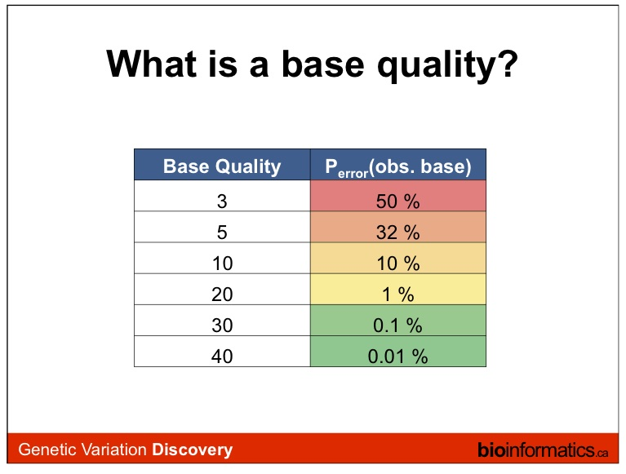
Q = -10 log_10 (p)
Where Q is the quality and p is the probability of the base being incorrect.

Slide 11
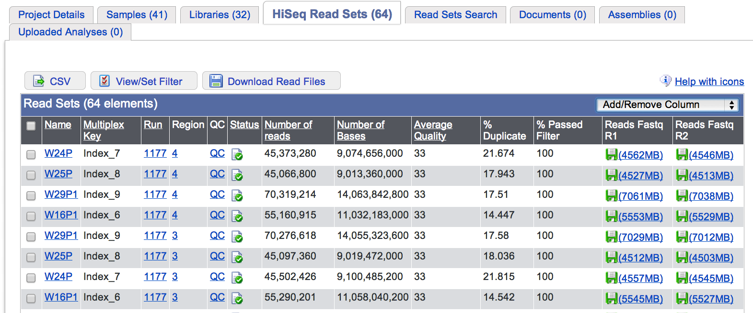
QC of raw sequences

Slide 12
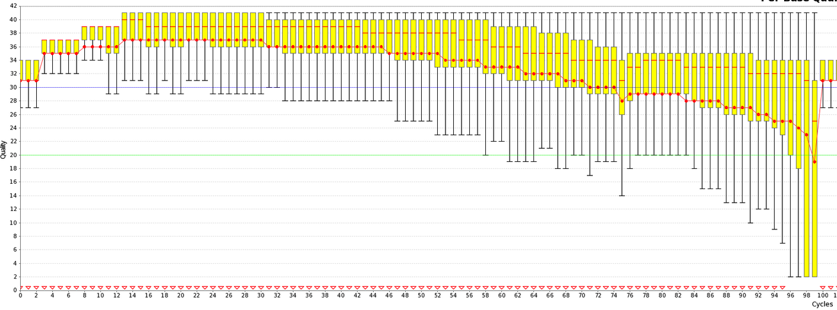
QC of raw sequences
low qualtity bases can bias subsequent anlaysis
(i.e, SNP and SV calling, …)

Slide 13
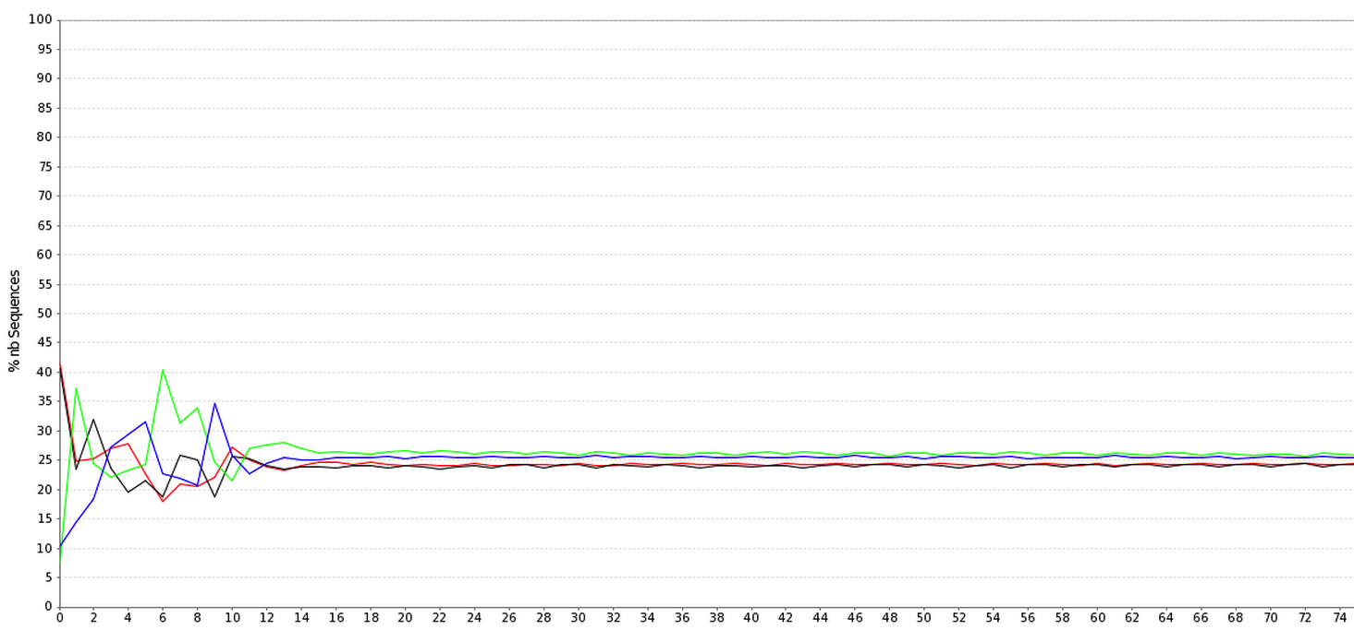
QC of raw sequences
Positional Base-Content

Slide 14
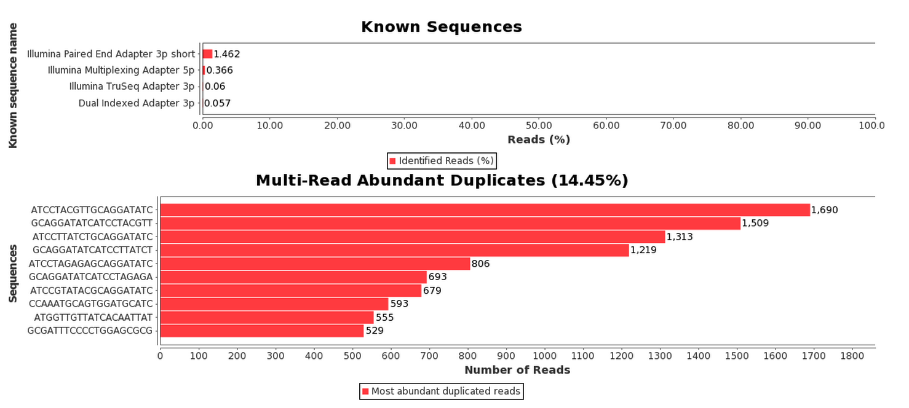
QC of raw sequences

Slide 15
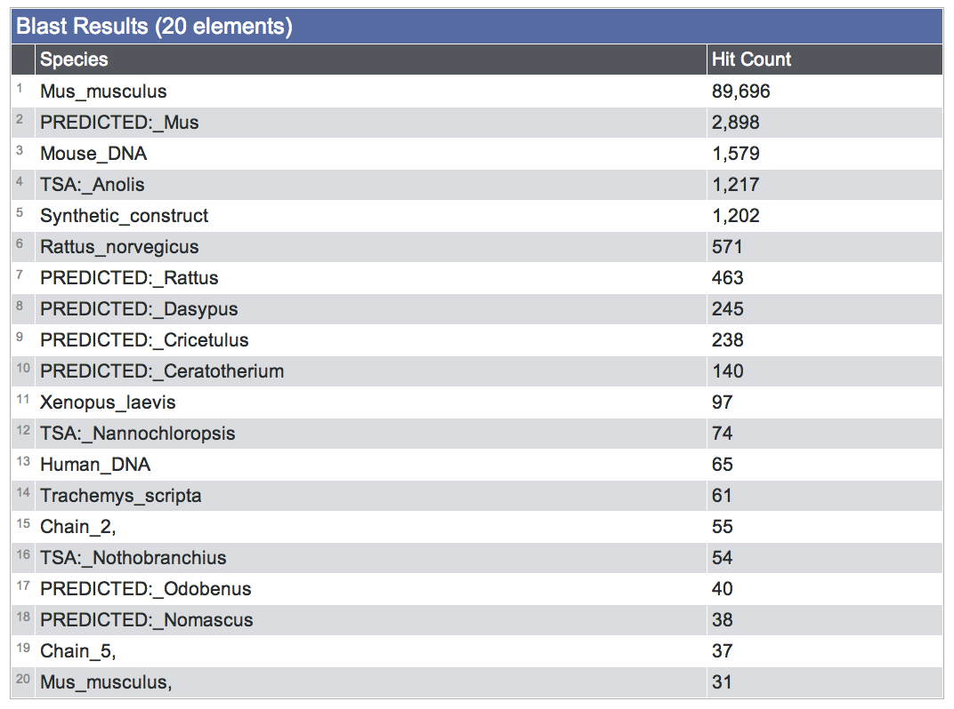
QC of raw sequences
Species composition (via BLAST)

Slide 16
RNA-Seq: Trimming and Filtering

Slide 17

Read Filtering
Clip Illumina adapters:
Trim trailing quality < 30
Filter for read length ≥ 32 bp
usadellab.org

Slide 18
RNA-Seq: Mapping

Slide 19
Assembly vs. Mapping
mapping
all vs reference
Reference
reads
contig1
contig2
assembly
all vs all

Slide 20
RNA-seq: Assembly vs Mapping
Reference-based RNA-seq
Ref. Genome or Transcriptome
RNA-seq
reads
De novo RNA-seq
contig1
contig2

Slide 21
Read Mapping
Mapping problem is challenging:
  Need to map millions of short reads to a genome
  Genome = text with billons of letters
  Many mapping locations possible
  NOT exact matching: sequencing errors and biological variants (substitutions, insertions, deletions, splicing)
Clever use of the Burrows-Wheeler Transform increases speed and reduces memory footprint
Other mappers: BWA, Bowtie, STAR, GEM, etc.

Slide 22
TopHat: Spliced Reads
Bowtie-based
TopHat: finds/maps to possible splicing junctions.
Important to assemble transcripts later (cufflinks)

Slide 23
SAM/BAM
Control1.bam
KnockDown1.bam
~ 10Gb each bam
Control2.bam
SRR013667.1 99 19 8882171 60 76M = 8882214 119
NCCAGCAGCCATAACTGGAATGGGAAATAAACACTATGTTCAAAG
KnockDown2.bam
SRR013667.1 99 19 8882171 60 76M = 8882214 119
NCCAGCAGCCATAACTGGAATGGGAAATAAACACTATGTTCAAAG
Used to store alignments
SAM = text, BAM = binary
SRR013667.1 99 19 8882171 60 76M = 8882214 119
NCCAGCAGCCATAACTGGAATGGGAAATAAACACTATGTTCAAAGCAGA
#>A@BABAAAAADDEGCEFDHDEDBCFDBCDBCBDCEACB>AC@CDB@>
…
Read name
Flag
Reference Position
CIGAR
Mate Position
Bases
Base Qualities
SAM: Sequence Alignment/Map format

Slide 24

The BAM/SAM format
samtools.sourceforge.net
picard.sourceforge.net
Sort, View, Index, Statistics, Etc.
$ samtools flagstat C1.bam
110247820 + 0 in total (QC-passed reads + QC-failed reads)
0 + 0 duplicates
110247820 + 0 mapped (100.00%:nan%)
110247820 + 0 paired in sequencing
55137592 + 0 read1
55110228 + 0 read2
93772158 + 0 properly paired (85.06%:nan%)
106460688 + 0 with itself and mate mapped
3787132 + 0 singletons (3.44%:nan%)
1962254 + 0 with mate mapped to a different chr
738766 + 0 with mate mapped to a different chr (mapQ>=5)
$

Slide 25
RNA-Seq: Alignment QC

Slide 26
RNA-seQc summary statistics
broadinstitute.org/cancer/cga/rna-seqc

Slide 27
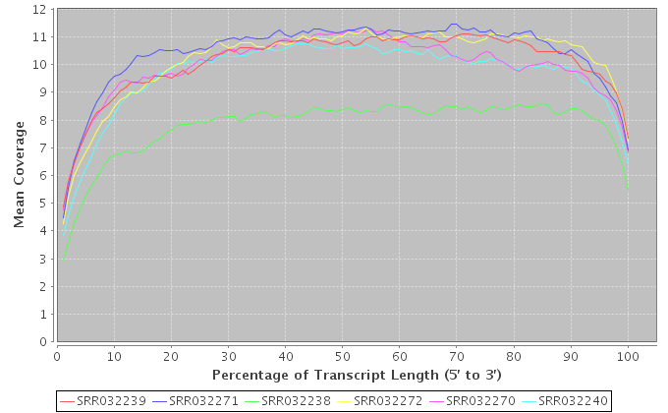
RNA-seQc covergae graph

Slide 28
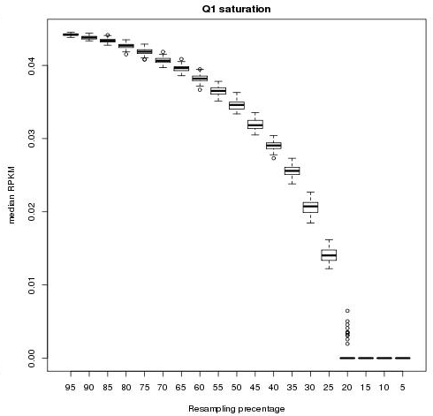
Home-made Rscript: saturation
RPKM Saturation Analysis

Slide 29
RNA-Seq:Wiggle

Slide 30
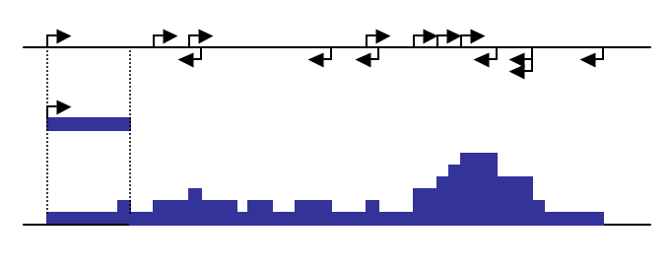
UCSC: bigWig Track Format
The bigWig format is for display of dense, continuous data that will be displayed in the Genome Browser as a graph.
Count the number of read (coverage at each genomic position:
Modified from http://biowhat.ucsd.edu/homer/chipseq/ucsc.html

Slide 31
RNA-Seq:Gene-level counts

Slide 32

HTseq:Gene-level counts
Contro1: 11 reads
Control2: 16 reads
KnockDown1: 4 reads
KnockDown2: 5 reads
TSPAN16
Reads (BAM file) are counted for each gene model (gtf file) using HTSeq-count:
www-huber.embl.de/users/anders/HTSeq

Slide 33
RNA-seq: EDA

Slide 34
gqSeqUtils R package: Exploratory Data Analysis

Slide 35
RNA-Seq:Gene-level DGE

Slide 36
Home-made Rscript: Gene-level DGE
edgeR and DESeq : Test the effect of exp. variables on gene-level read counts
GLM with negative binomial distribution to account for biological variability (not Poisson!!)
DEseq
edgeR

Slide 37
Differential Gene Expression
Downstream Analyses
Pathways/Gene Set (e.g. GOSeq)
Regulatory Networks
Machine Learning / Classifiers

Slide 38
RNA-Seq:Transcript-level DGE

Slide 39
Cufflinks: transcipt assembly
Assembly: Reports the most parsimonious set of transcripts (transfrags) that explain splicing junctions found by TopHat

Slide 40
Cufflinks: transcript abundance
Quantification: Cufflinks implements a linear statistical model to estimate an assignment of abundance to each transcript that explains the observed reads with maximum likelihood.

Slide 41

Cufflinks: abundance output
Cufflinks reports abundances as Fragments Per Kilobase of exon model per Million mapped fragments (FPKM)
Normalizes for transcript length and lib. size
C: Number of read pairs (fragments) from transcript
N: Total number of mapped read pairs in library
L: number of exonic bases for transcript

Slide 42
Cuffdiff: differential transcript expression
Cudiff
  Tests for differential expression of a cufflinks assembly

Slide 43
RNA-Seq:Generate report

Slide 44
Home-made Rscript
Generate report
  Noozle-based html report which describe the entire analysis and provide a general set of summary statistics as well as the entire set of results
Files generated:
  index.html, links to detailed statistics and plots
For examples of report generated while using our pipeline please visit our website

