Slide 1
Part one Presentation of Mustafa Al-Jak
EXCEL
Electronic Schedule Programme

Slide 2
Microsoft Excel
Excel : This is the computational and mathematical electronic tables programme.
User helps to easily build tables and make simple and easily complex calculations. One of the characteristics of Excel is that it is user-friendly and easy to learn .
This programme belongs to a total of offices (extended tables, SPREAD SHEET or accounting tables) and uses its dimension to store accounting data.

Slide 3
Key objective of the design of the electronic tables programme
Microsoft Excel:
The storage of data, statistical calculations and analyses thereof and the creation of the charts they represent through user-friendly orders.

Slide 4
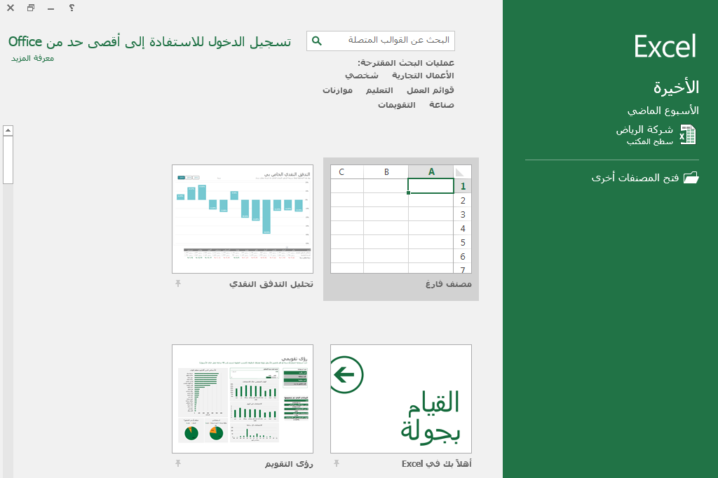
Start screen

Slide 5
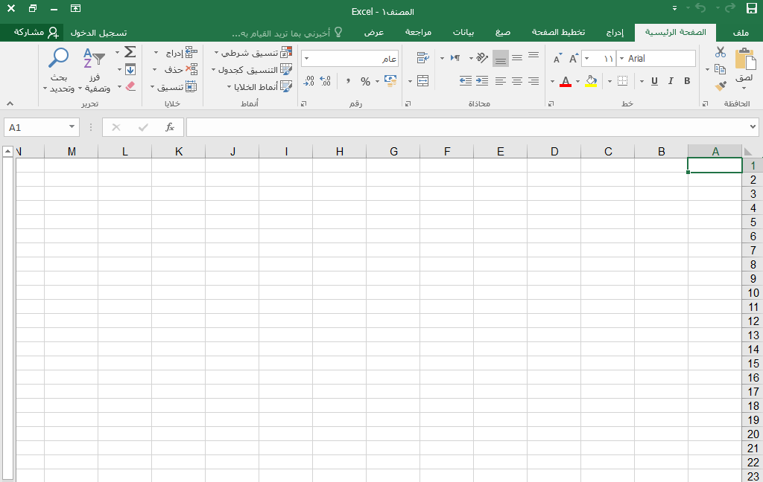
Parts of the working paper
Title strip
List toolkit
List tape
Drafting requirement
Title of cell :
Begin in column name
Then Grade Number
A1

Slide 6
Parts of the working paper
Title of columns
Class numbers
Screening strip
Working papers

Slide 7
Microsoft Excel
How to identify the cell and define a range of cells.
In order to determine which cell we are pressuring, we will note that the cell has been identified and we also note that the cell has met, activated and appeared in the cell name box.
To determine the range (s) of cells that put pressure on the left diamond-flower continuously and then pass on the cells to be determined while continuing to pressure.
To identify a set of dispersed cells
Past onC2 cell for selection , then pressured Ctrl's key with a continuum and climbed on A6 cell, he would note that Excel had identified those cells.
To define a column as a factor
Inspired on the heading of column I A, note the definition of the whole column
To determine a complete description
After the heading of Class 5, he noted the identification of the whole grade .
To determine the whole working paper: -
Rethinking on the right top of the working paper, he noted that each working paper had been identified

Slide 8
Exyl work
The Book work consists of three working papers.
The single working paper is controversies consisting of the intentional nature and description of the titles of the term, which are English alphabetical, with 256 columns of all classes numbered in series 1-65536.
Each cell is the result of the intersection of the column with the row, for example A1, in column A and Class 1.

Slide 9
Start-up of work with Exyl
Establishment of a new document.
Preservation of a document on behalf of
Opening of a pre-archived document.
Renaming, deleting and reproducing working papers.
Freezing of panels .

Slide 10
Establishment of a new work

Slide 11
Microsoft Excel
How to write within the cell .
For example, to become the current cell, we place the Honour Index on B2 and agree on it once, write a word of hope and then lapse on the Enter data entry key
We also note that when the data are entered in B2 cell, the information entered into in the cell and in the formula tape appears and that the mark is on a foot of a formula and cover-up that rewards pressure on Enter, that is, acceptance of the data entered , and the visit x rewards pressure on ESC, i.e. elimination of the data entered.
How to modify, edit and delete data from within the cell
To modify or edit data within the cell number by insisting on the cell to modify or delete the data within which two points are made, it will be noted that the book index appears within the cell at which time you can modify, edit or delete the data within the cell.

Slide 12
Cell mobilization

Slide 13
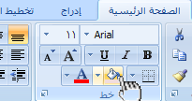
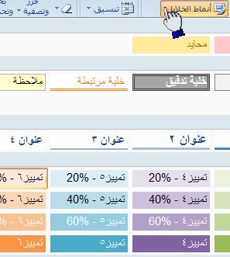
Microsoft Excel
How to mobilize cells with a particular color:
- the pre-defined cell requirement :
In addition to mobilizing blood cells, we can also mobilize them from (cell patterns), which are selected colours with a more efficient cell mobilization programme faster by selecting a particular color of cell patterns and applying it to cells more quickly

Slide 14
Cell coordination

Slide 15
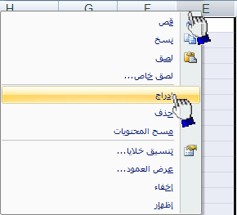
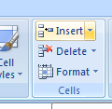
Microsoft Excel
Appointment of a specific offer by Mayor
Change column presentation to contain contents
How to include a new column or description

Slide 16
Excel programme
Workbook
Row is a buffer line of cells and there is a number referring to each class
Columnis a vertical line of cells and there is a letter referring to each column .

Slide 17
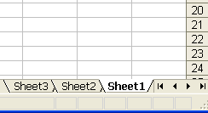
Excel programme
Signs of consolidation of the working paper
Existing marks include the working paper, where each work is divided into several working groups

Slide 18
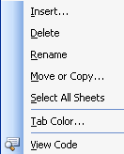
Excel programme
Signs of consolidation of the working paper
A new paper could be added or a paper deleted or a paper renamed... by pressuring the right fugitive on the active paper showing the following list:

Slide 19
Excel programme
Completion of a textual or digital series
This is a feature of Excel's time saving programme

Slide 20
Sport formulas
To write the formula, it must begin with an indication of equality following the titles of cells to be calculated and the desired accounting transactions and then visit Enter to present the result in the active cell.
A1*B2 + C3=
Arrangement is important in sports formulas, as beatings and partition take place before gathering and surrounding .
The wording could be modified by double coding on the cell or from the equation line.

Slide 21
Calculation factors
Factor | Meaning | Example
% | Percentage | 5%
+ | Collection process | 5 +10
- | Exposure process | 5 – 10
* | The beatings | 3 * 5
/ | Breakdown process | 10 / 2
^ | Asbestos (force) | 3: 2

Slide 22
EXCEL
Electronic Schedule Programme
Part two

Slide 23
Prepared formulas
They are sports formulas that have been briefly defined by Excel.
Text written by user: = A1 + A2 + A3
Format in the programme: SUM(A1:A3)

Slide 24
Dalit Library

Slide 25
Examples of history and time
General version of the Guide | Purpose
=Date | Introduction of date
=Today | Restoration of the date of today
= Now | Restoration of the date of today Currently

Slide 26
Examples of textual States
General version of the Guide | Purpose
=LEN(D4) | Number of characters in the cell
TRIM(A4) | Reduce the vacuum for one cell
UPPER =UPPER(F6) | Small-scale transformation
LOWER(F7) | Large-scale transformation of young people

Slide 27
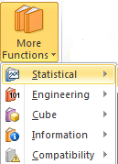
Examples for statistical purposes
Indicator | Purpose
Average(A1:A6) = | Creation of the accounting medium
Count(A1:A6) | To calculate the number of existing figures Within the scope
Max(A1:A6) | Maximum value within scope Maximum Value
Min = A1:A6 | Minimum value within scope Minimum Value

Slide 28
Examples of sports nations
Indicator | Purpose
SUM(A1:A6) SUM(A1, D2, B5 ) | Creation of total scope Creating a total of miscellaneous values
POWER(A1 ;2) | Power or sorrow
= SQRT(A1) | Reactivation of pedagogical roots
= INT(A2) | Close to the right number

Slide 29
EXCEL
Electronic Schedule Programme
Third part

Slide 30
Rationale months
Dal-IF
IF (Sea_test; value_if_true; value_if_false)
Ex :
IF (A1> =60'YES' =NO')

Slide 31
IF Dall
Its police function gives a particular value if the requirement is achieved and other value is achieved
If the condition is not met.

Slide 32
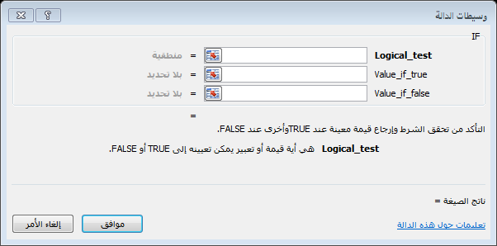
IF Dall

Slide 33
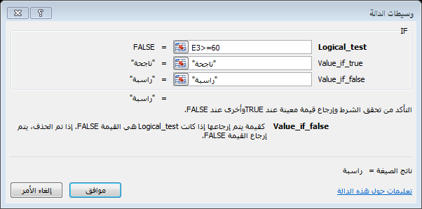
IF Dall
Requirement
Value of the successor if the condition is met
Value of the successor if not achieved

Slide 34
Outcome of IF

Slide 35
Rationale months
IF overlapping mode
IF = H7> =90;
"A";IF(H7> =80);
"B";IF(H7> =70);
"C";IF(H7> =60);
"D"H ”
))))

Slide 36
Drafting errors
Misstatement | Meaning
#NAME | Scope name corrected. Misstatement
#N/A | Not available . Value confirmed.
#REF | The cell reference is not valid .
#VALUE | Factor error.
#DIV/0 | Share on zero is not correct.
########### | The column is too narrow to offer the column.

Slide 37
Chart charts

Slide 38
Chart charts :
It is a representation of the data contained in the working paper at different fees and graphical formats.
For example :
Characteristic representation (Column).
Pie circular forms.
Area.

Slide 39
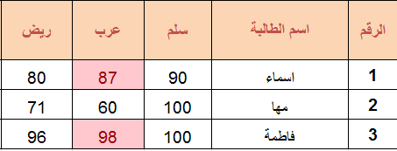
Representation of a chart of data

Slide 40
Planned tools
Design :
Change of colours .
Rapid planning.
Transfer of the scheme.
Coordination :
Types of form .
WordArt patterns.

Slide 41
Control of page characteristics
Control of printing trends.
Page size.
Control of page margins.

